Slide 1
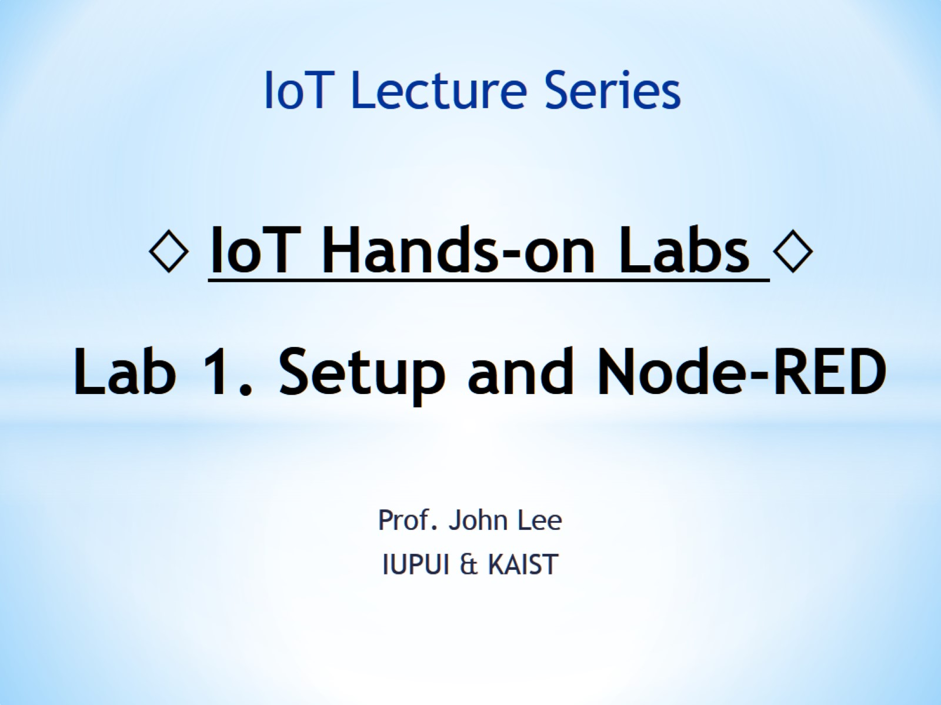
◊ IoT Hands-on Labs ◊ Lab 1. Setup and Node-RED

Slide 2
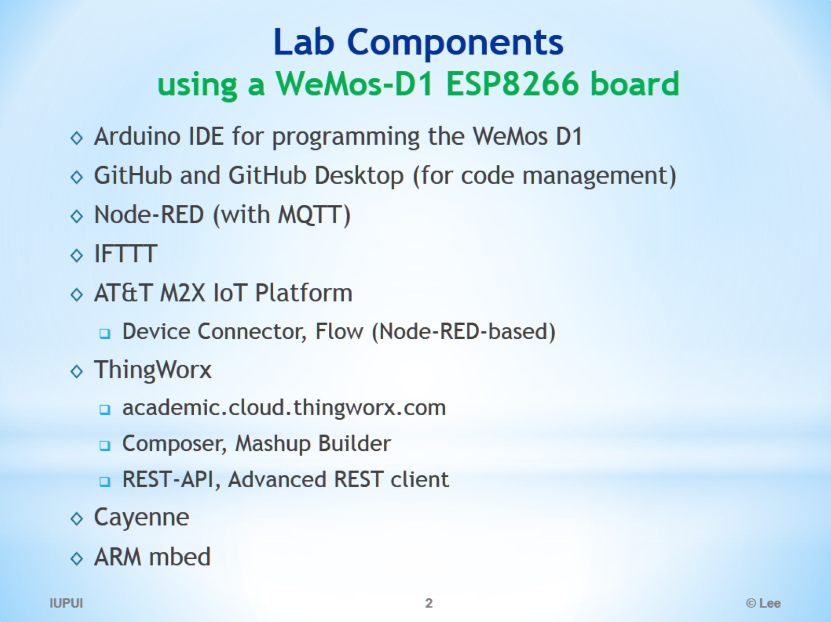
Lab Components using a WeMos-D1 ESP8266 board

Slide 3
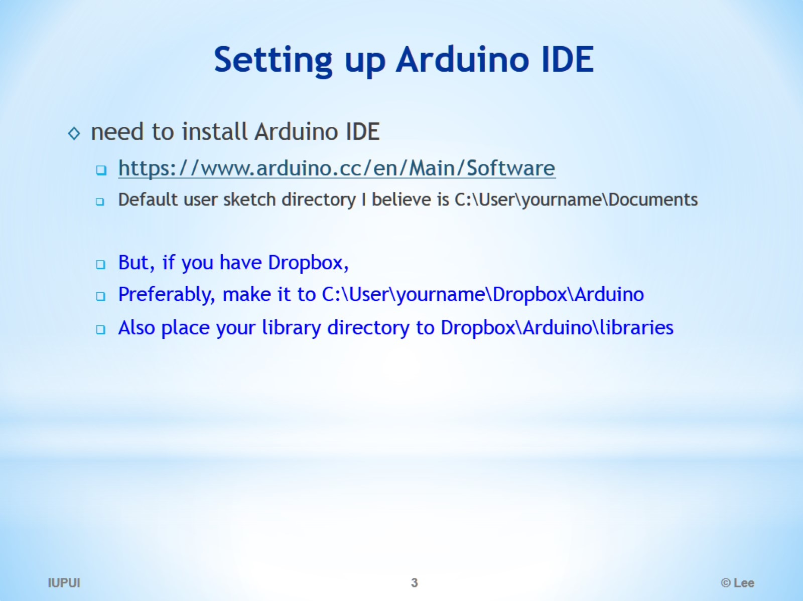
Setting up Arduino IDE

Slide 4
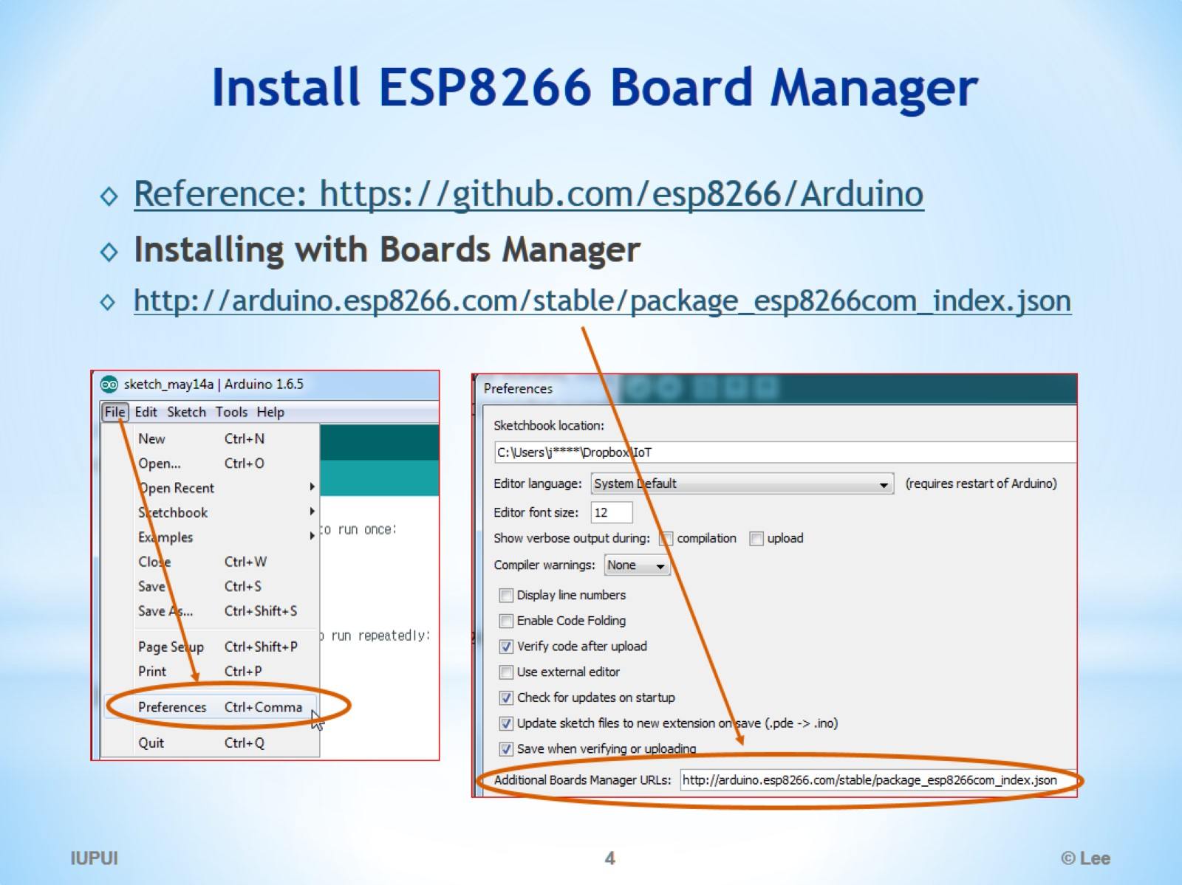
Install ESP8266 Board Manager

Slide 5
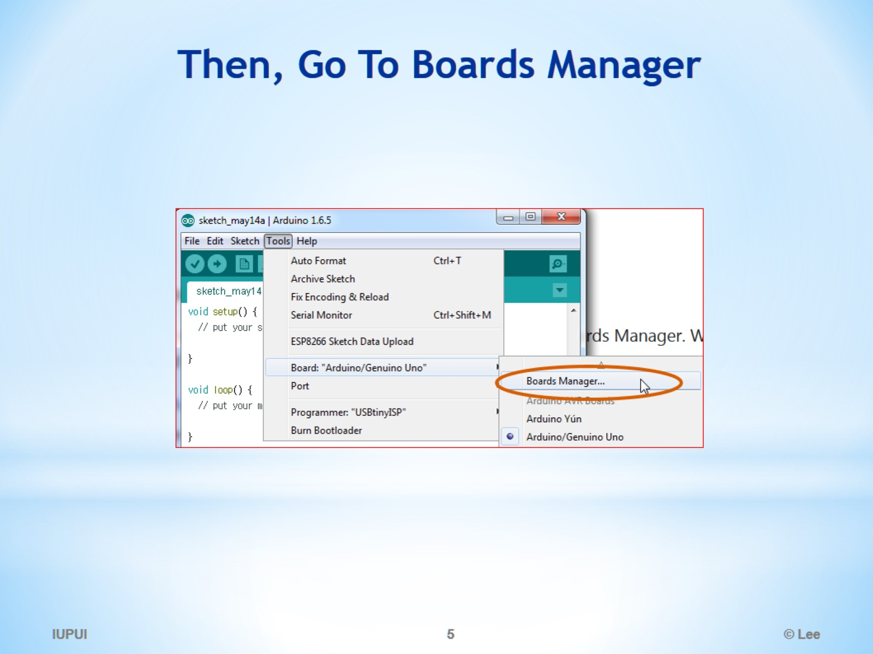
Then, Go To Boards Manager

Slide 6
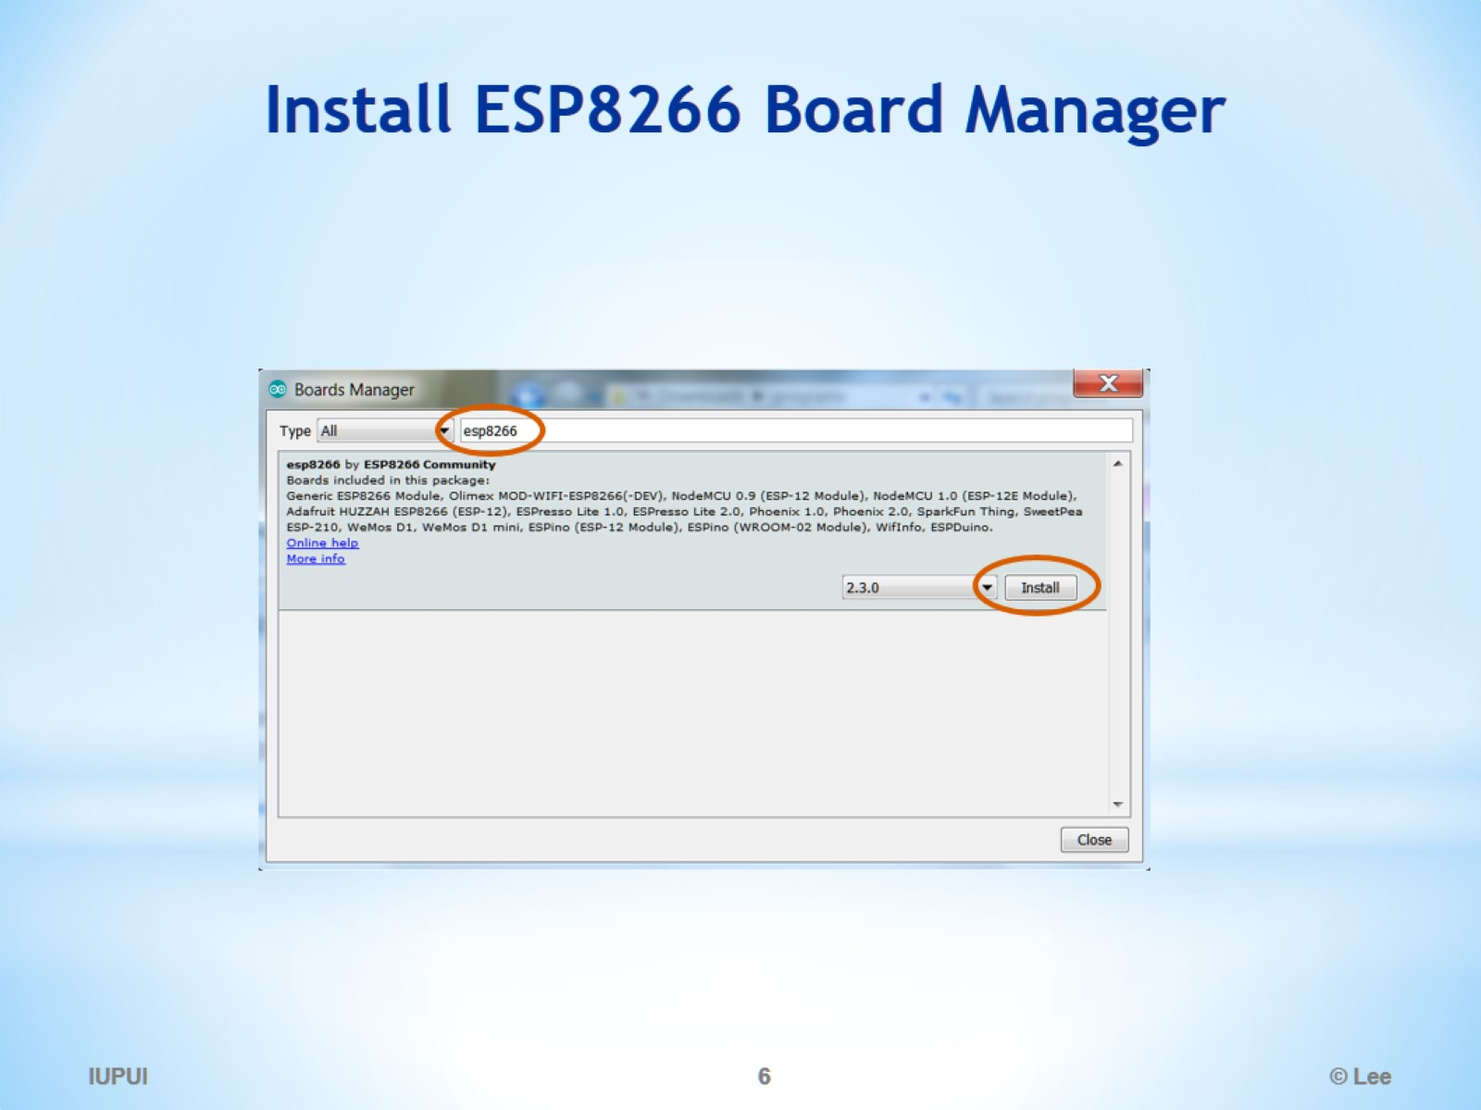
Install ESP8266 Board Manager

Slide 7
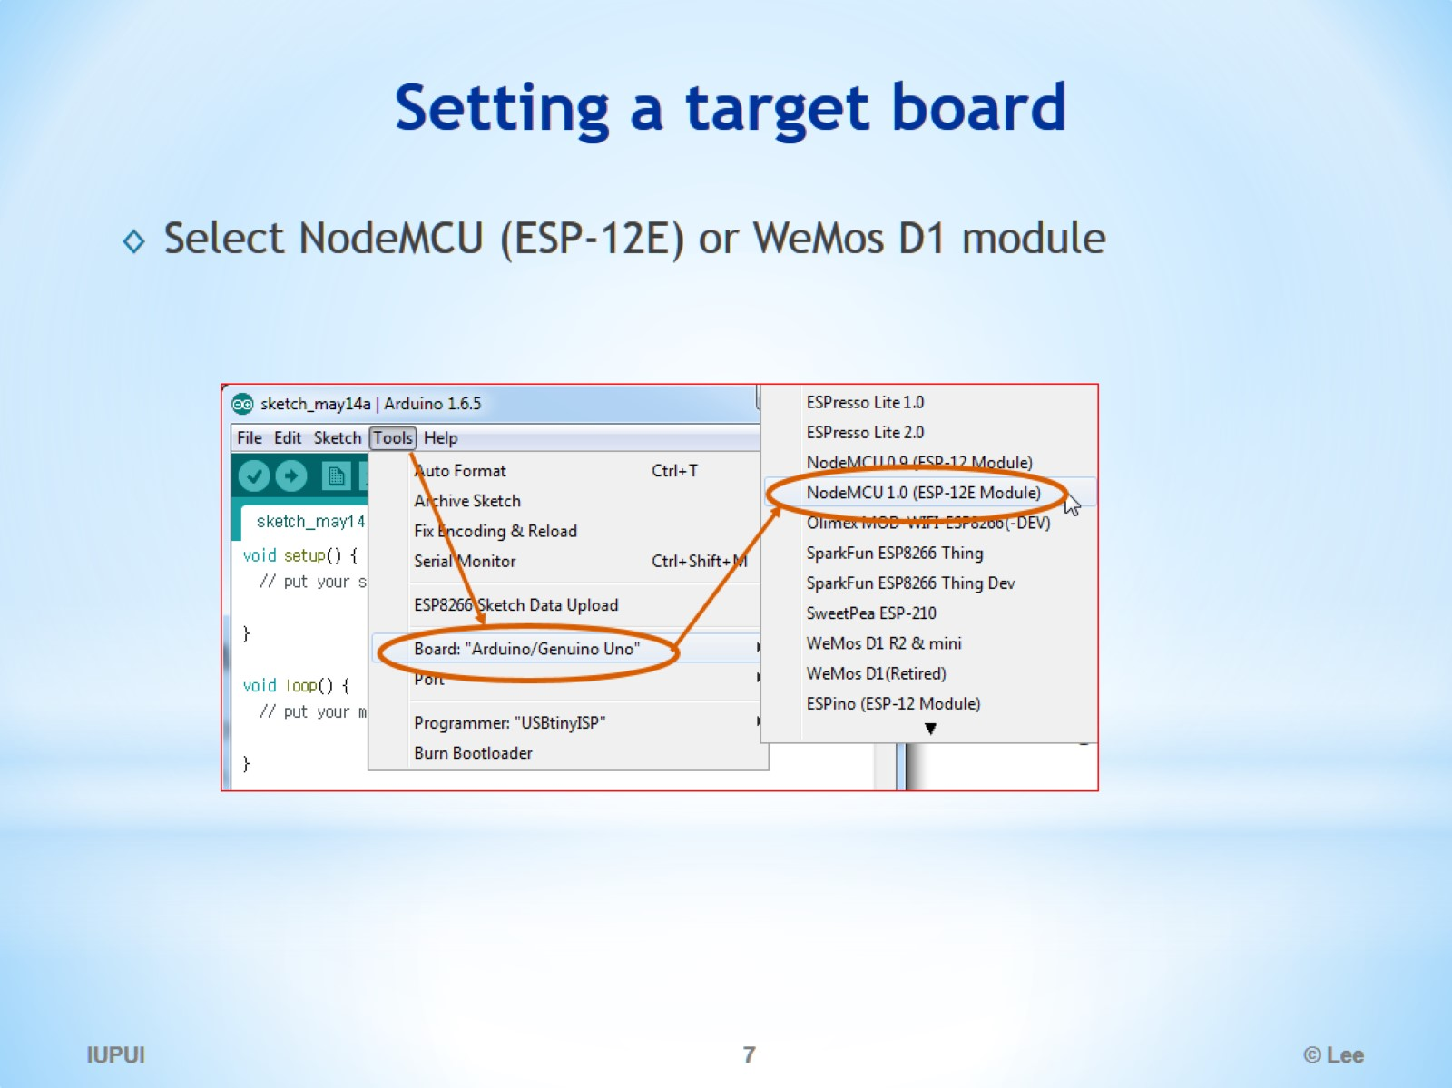
Setting a target board

Slide 8
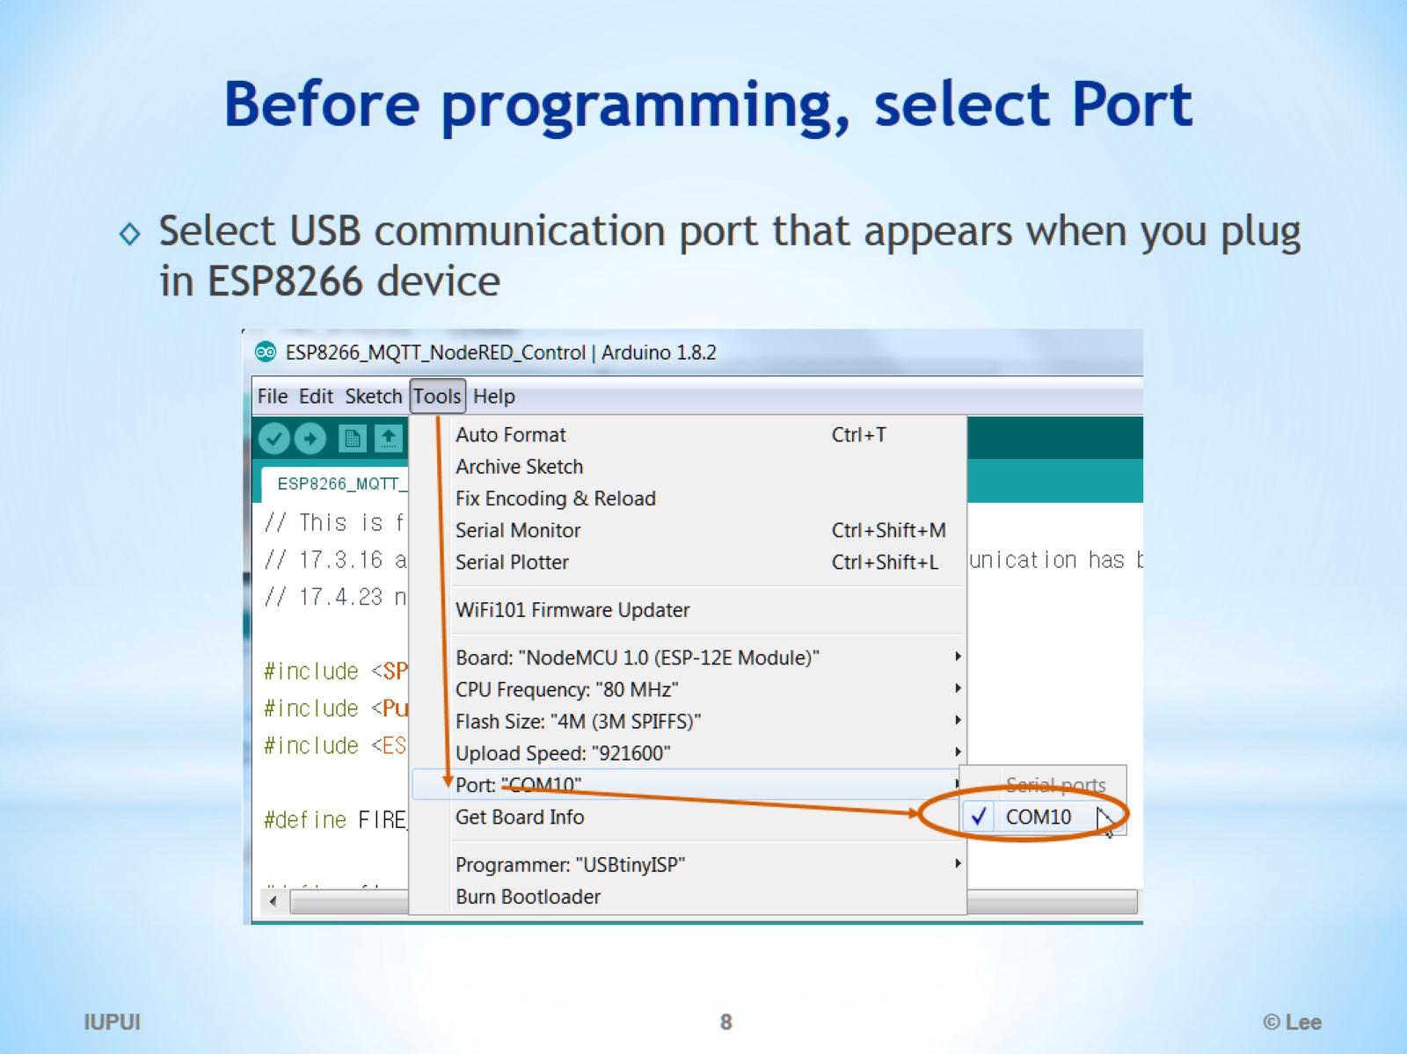
Before programming, select Port

Slide 9
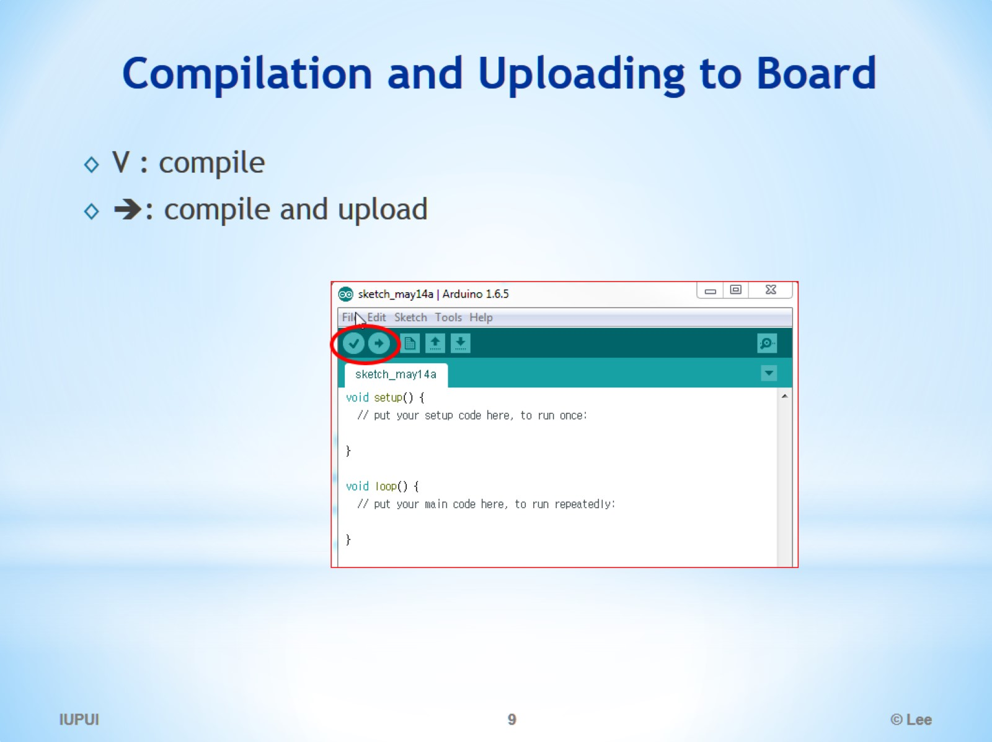
Compilation and Uploading to Board

Slide 10
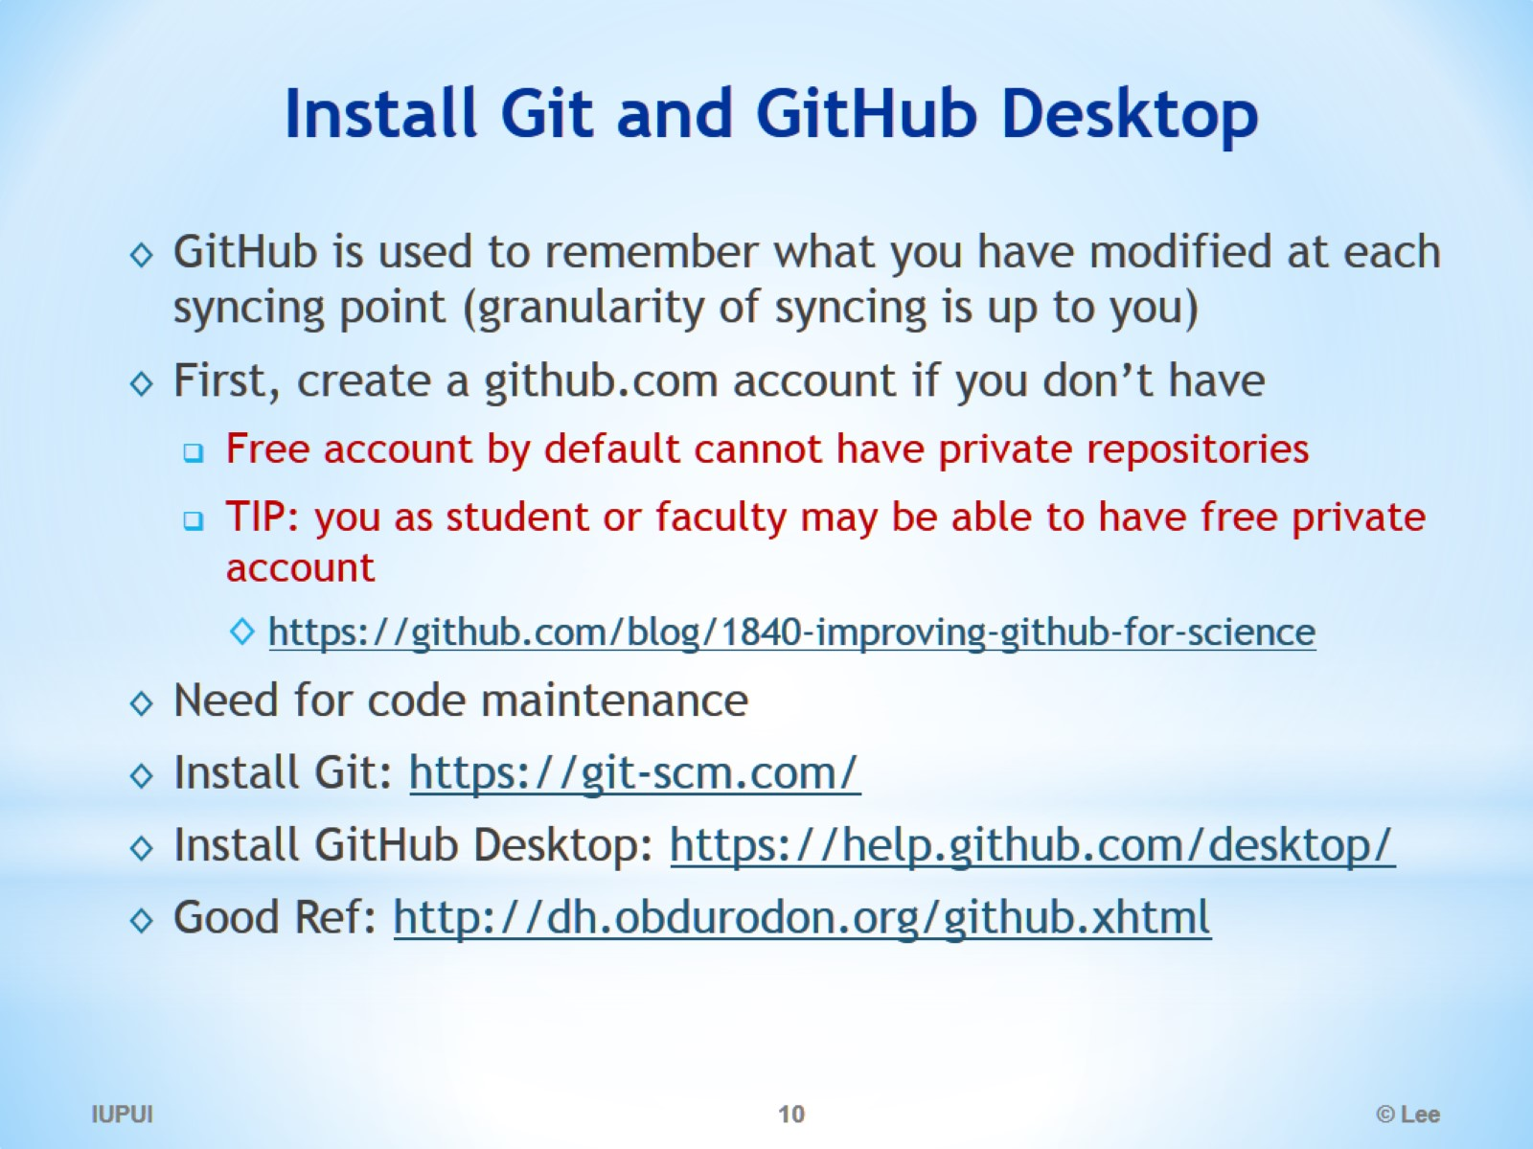
Install Git and GitHub Desktop

Slide 11
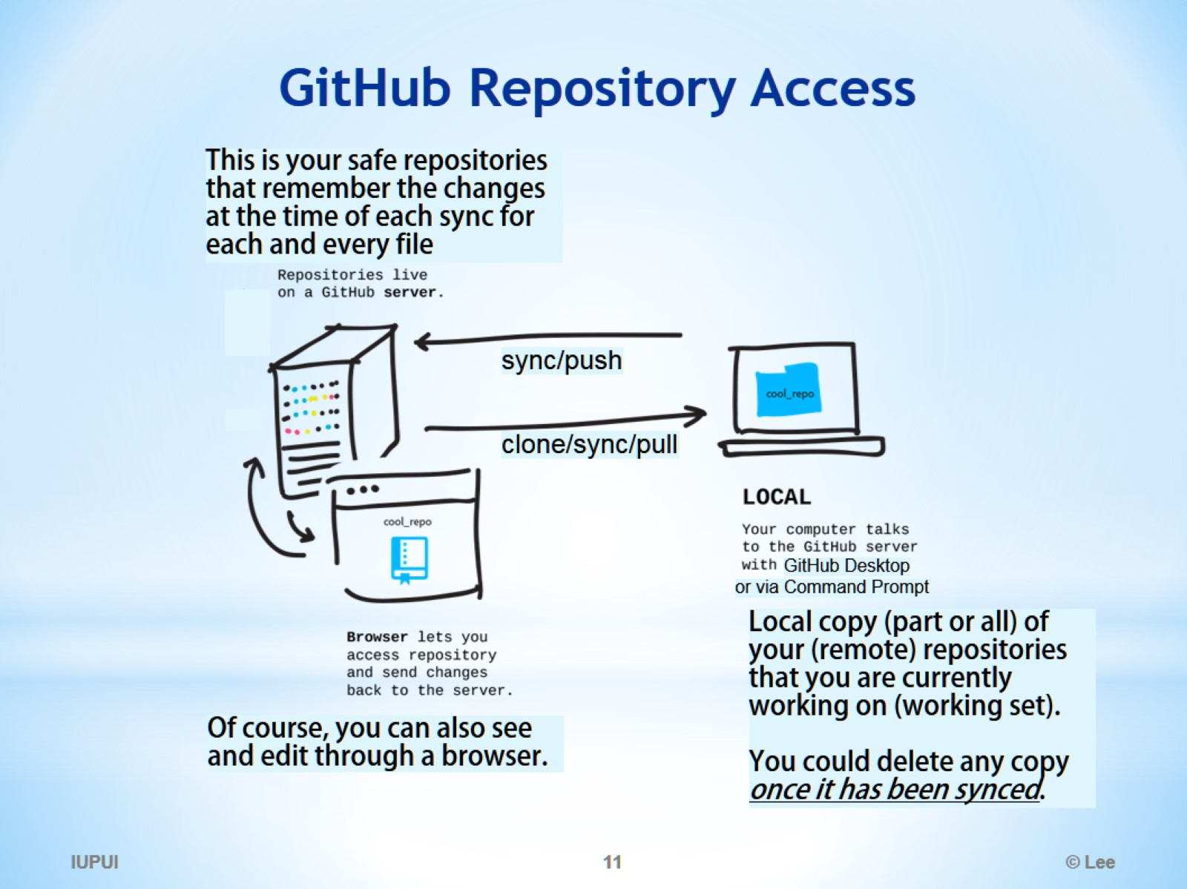
GitHub Repository Access

Slide 12
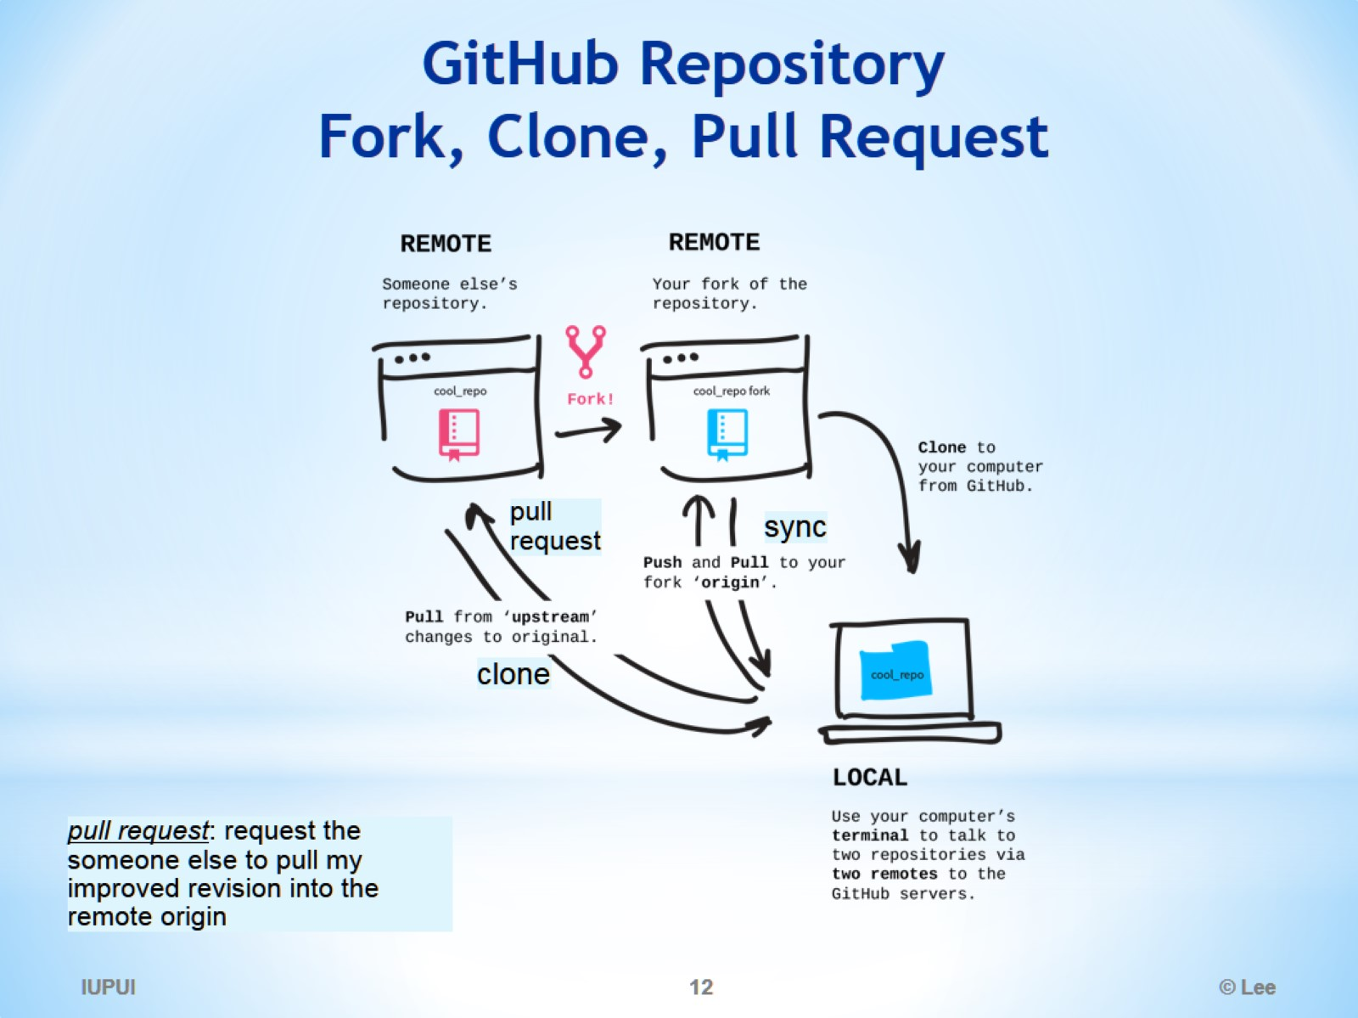
GitHub Repository Fork, Clone, Pull Request

Slide 13
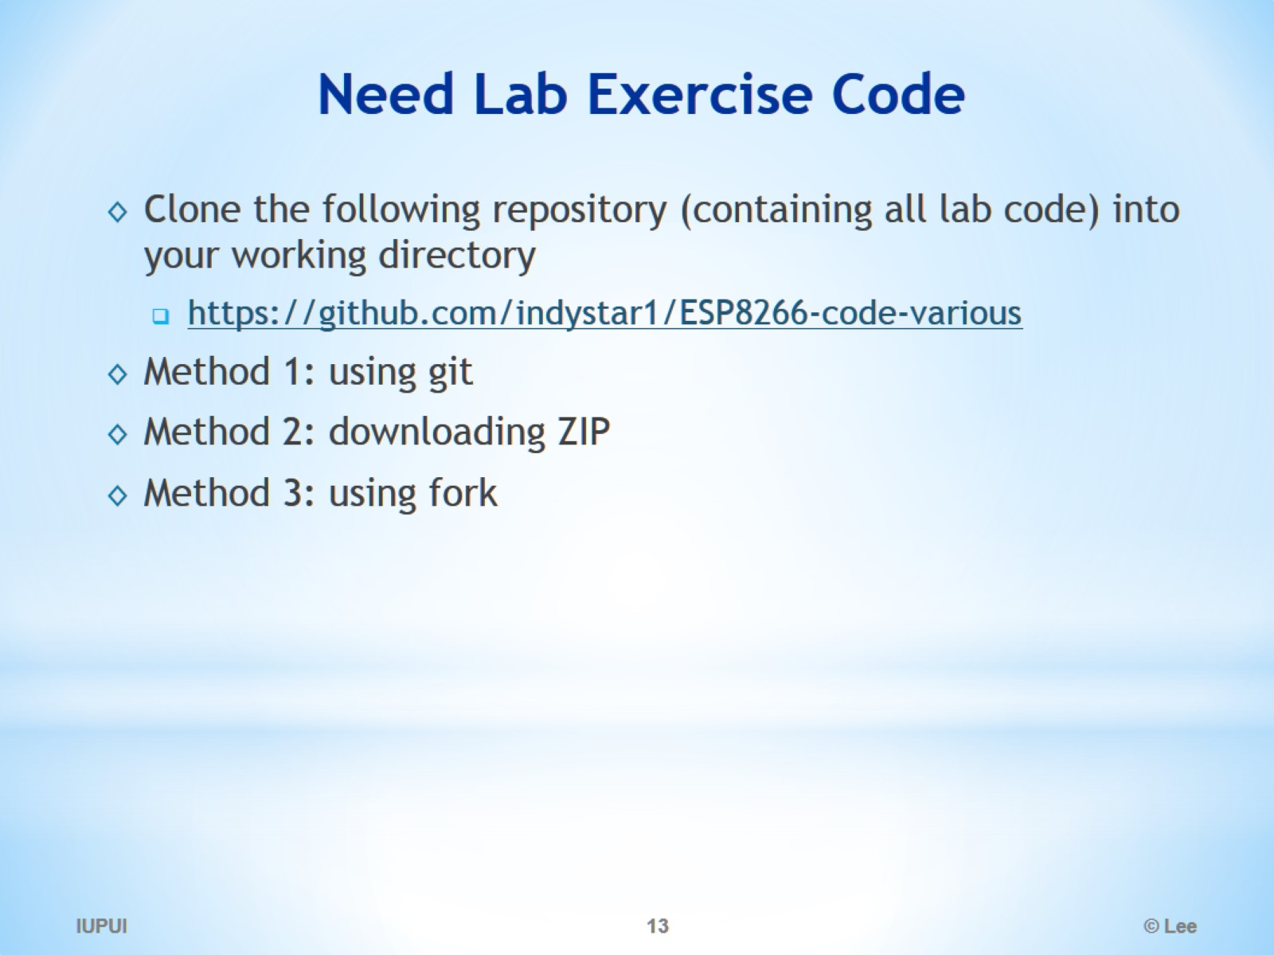
Need Lab Exercise Code

Slide 14
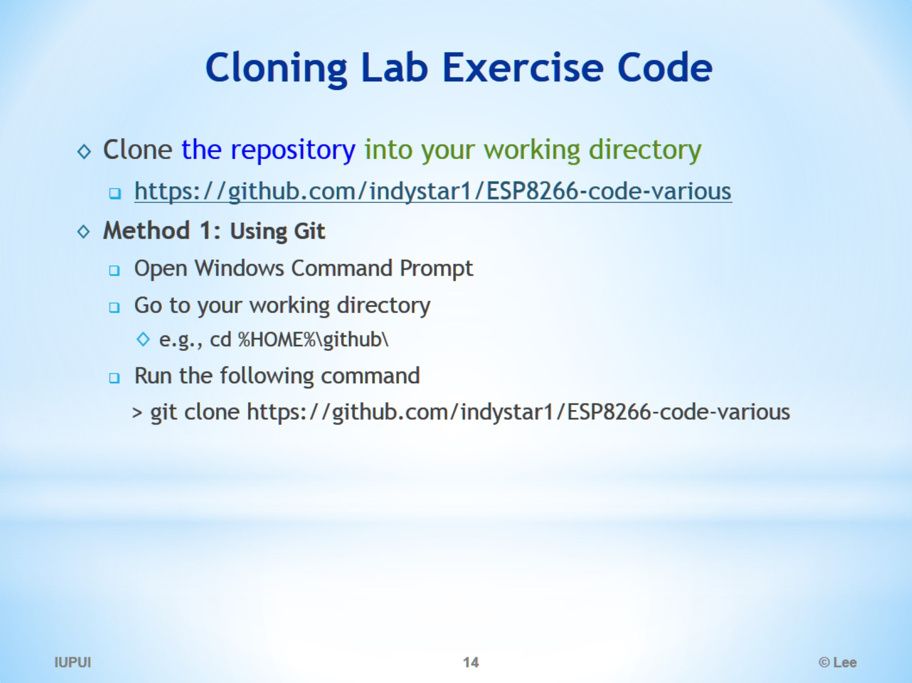
Cloning Lab Exercise Code

Slide 15
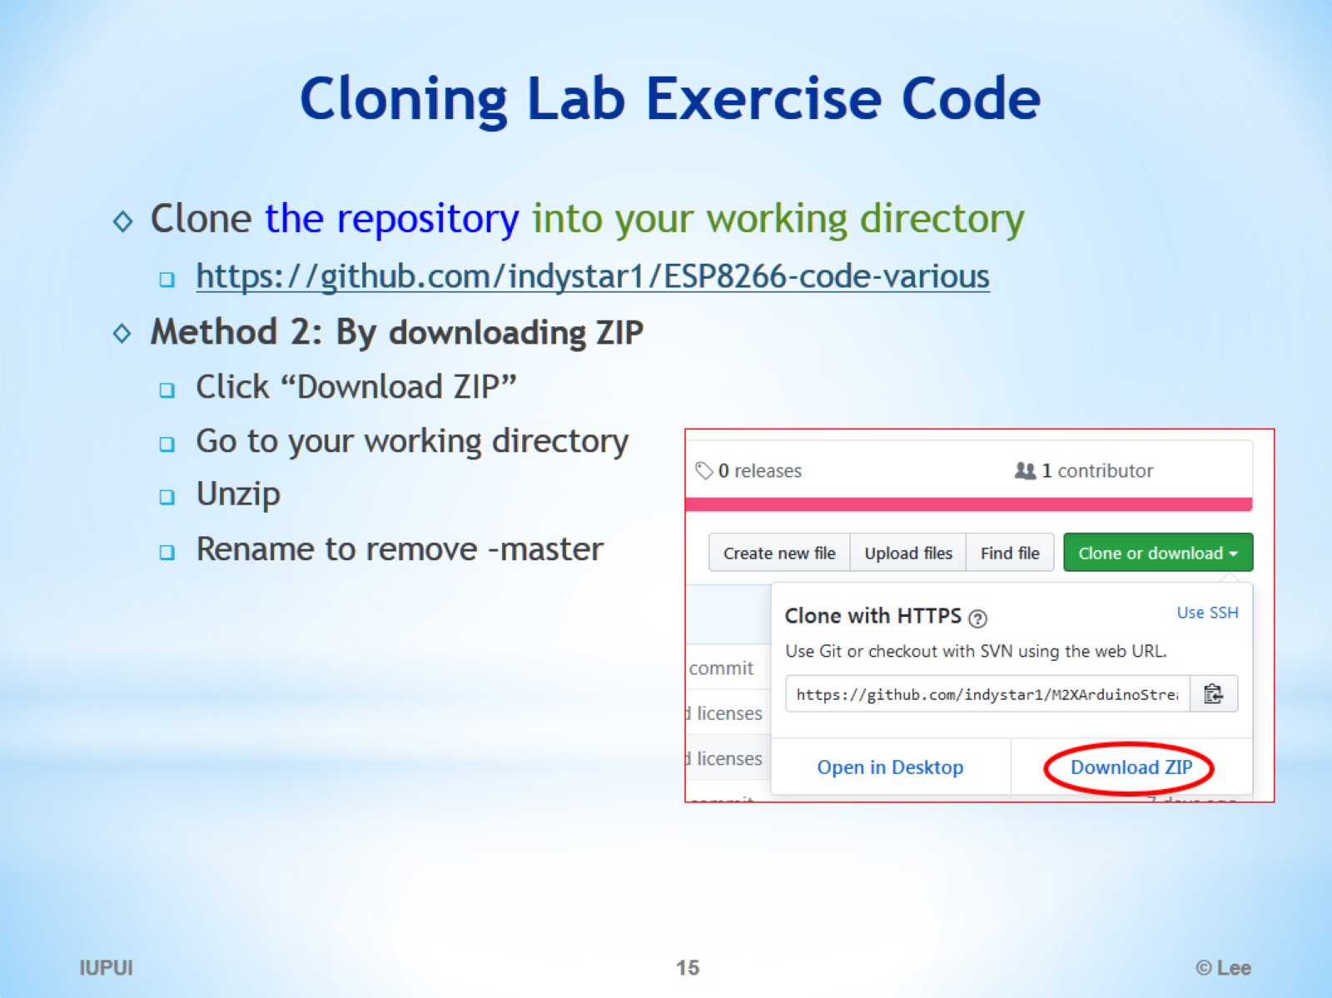
Cloning Lab Exercise Code

Slide 16
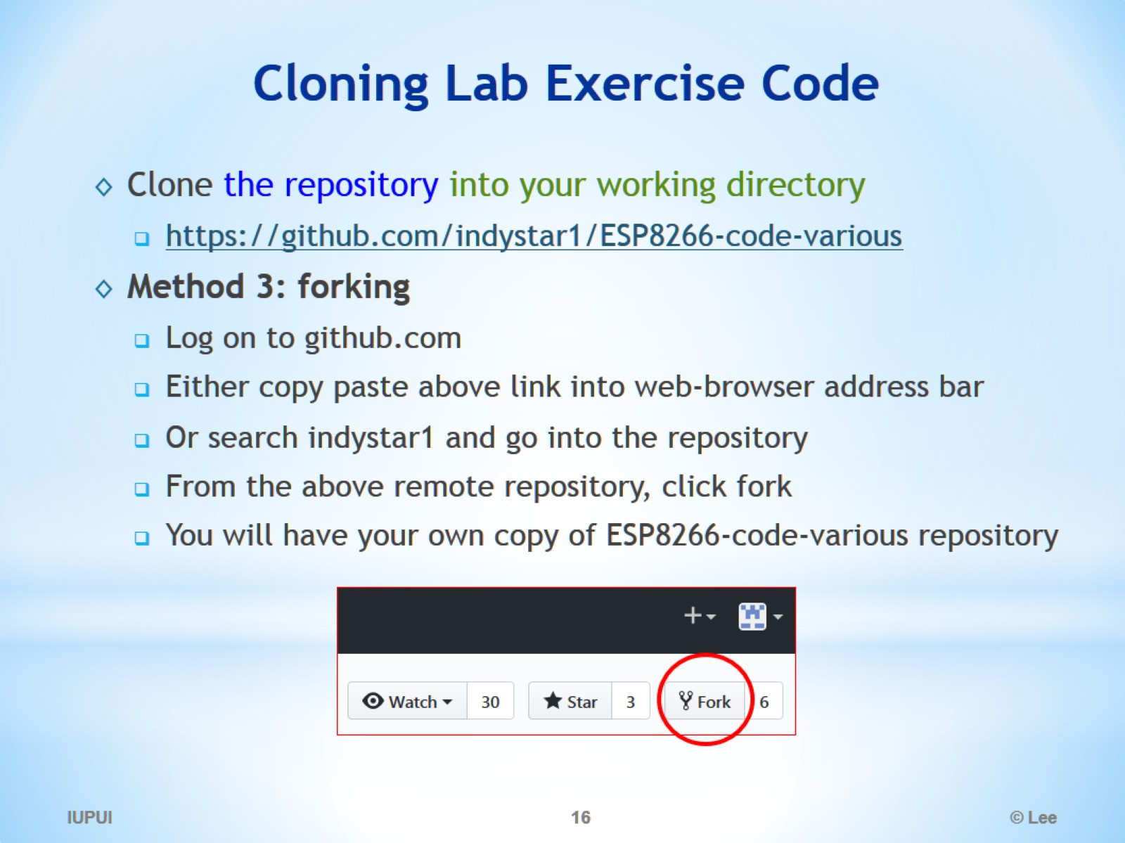
Cloning Lab Exercise Code

Slide 17
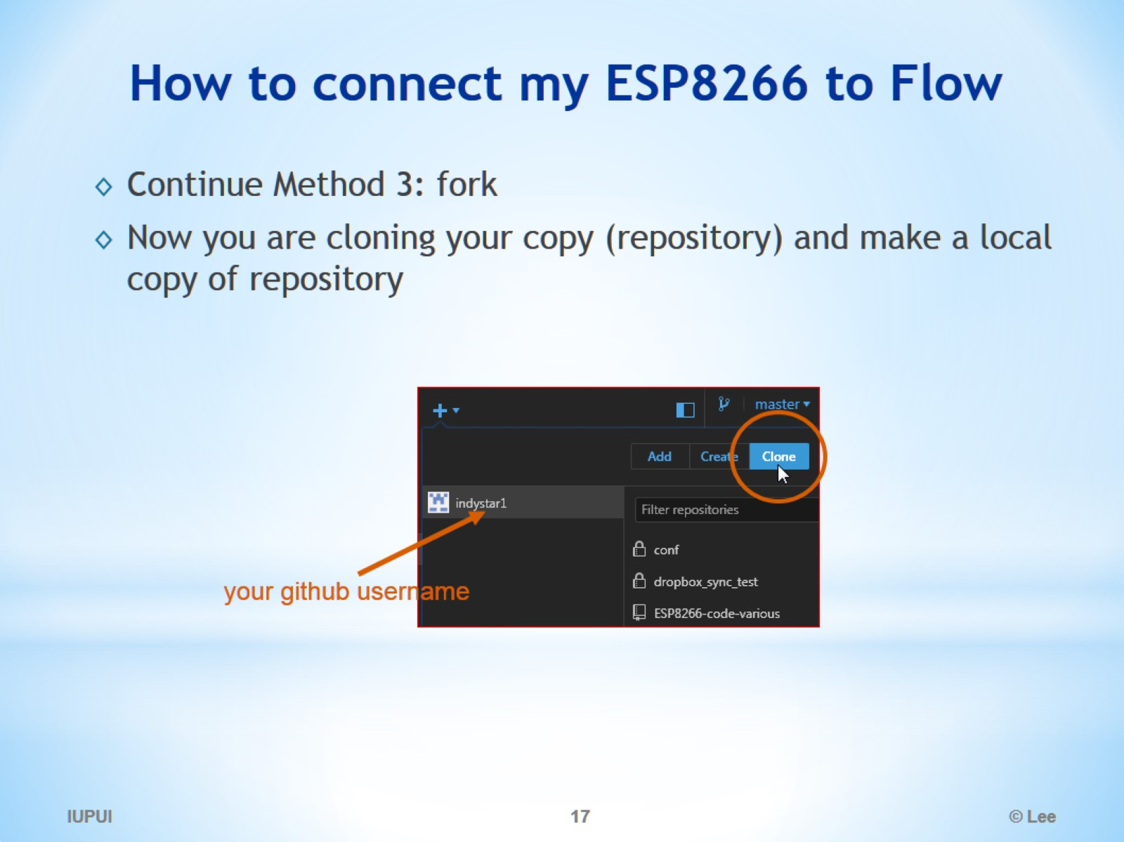
How to connect my ESP8266 to Flow

Slide 18
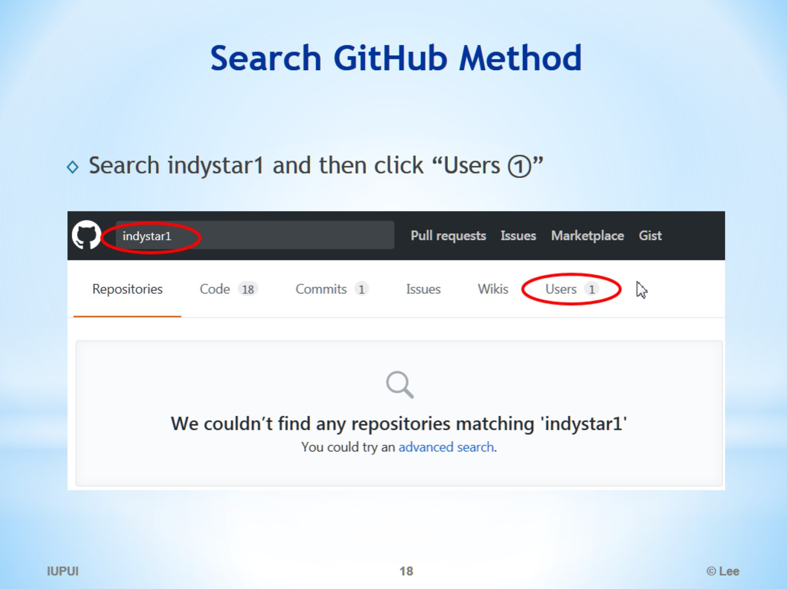
Search GitHub Method

Slide 19
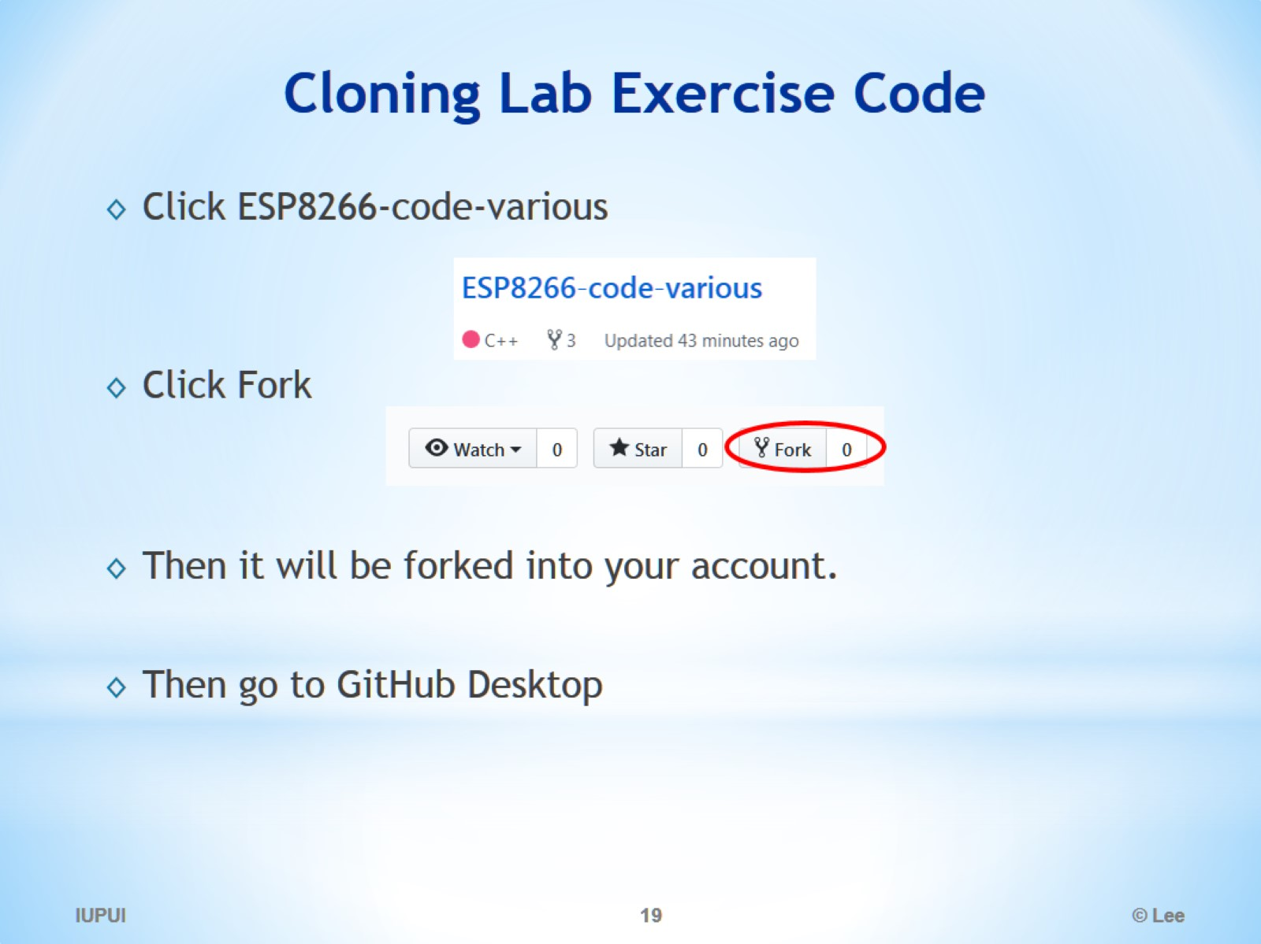
Cloning Lab Exercise Code

Slide 20
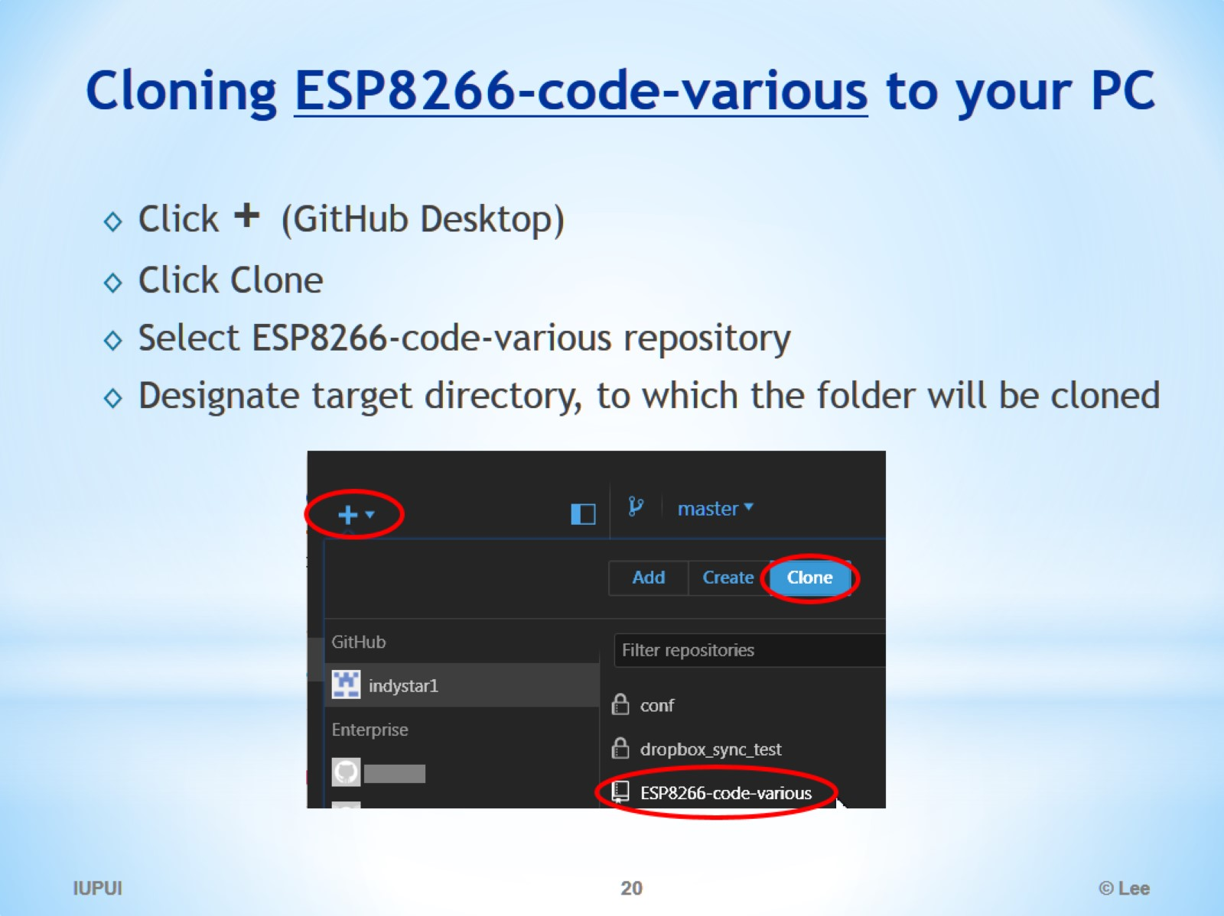
Cloning ESP8266-code-various to your PC

Slide 21
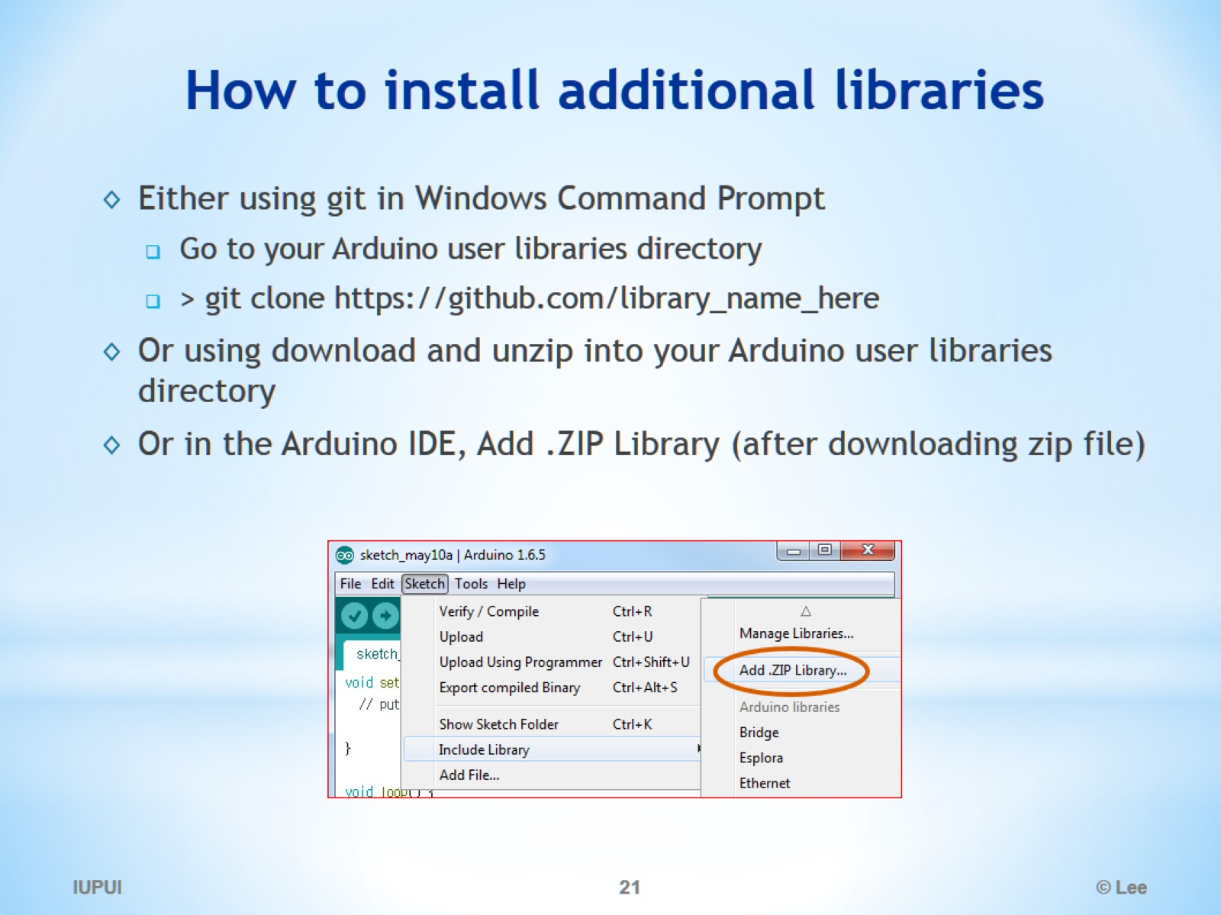
How to install additional libraries

Slide 22
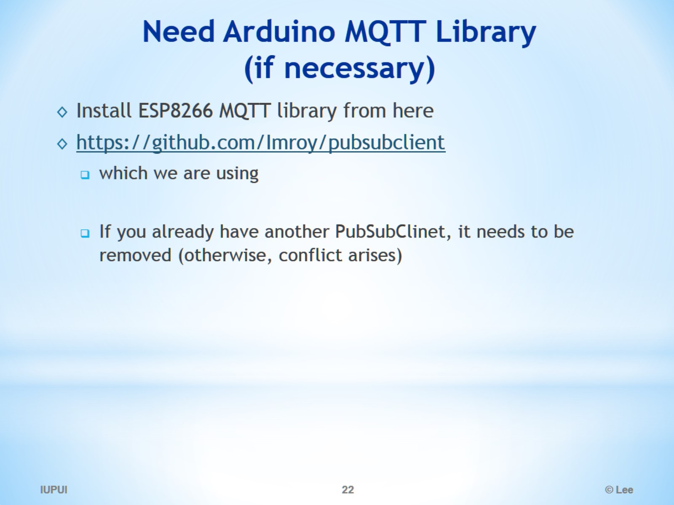
Need Arduino MQTT Library (if necessary)

Slide 23
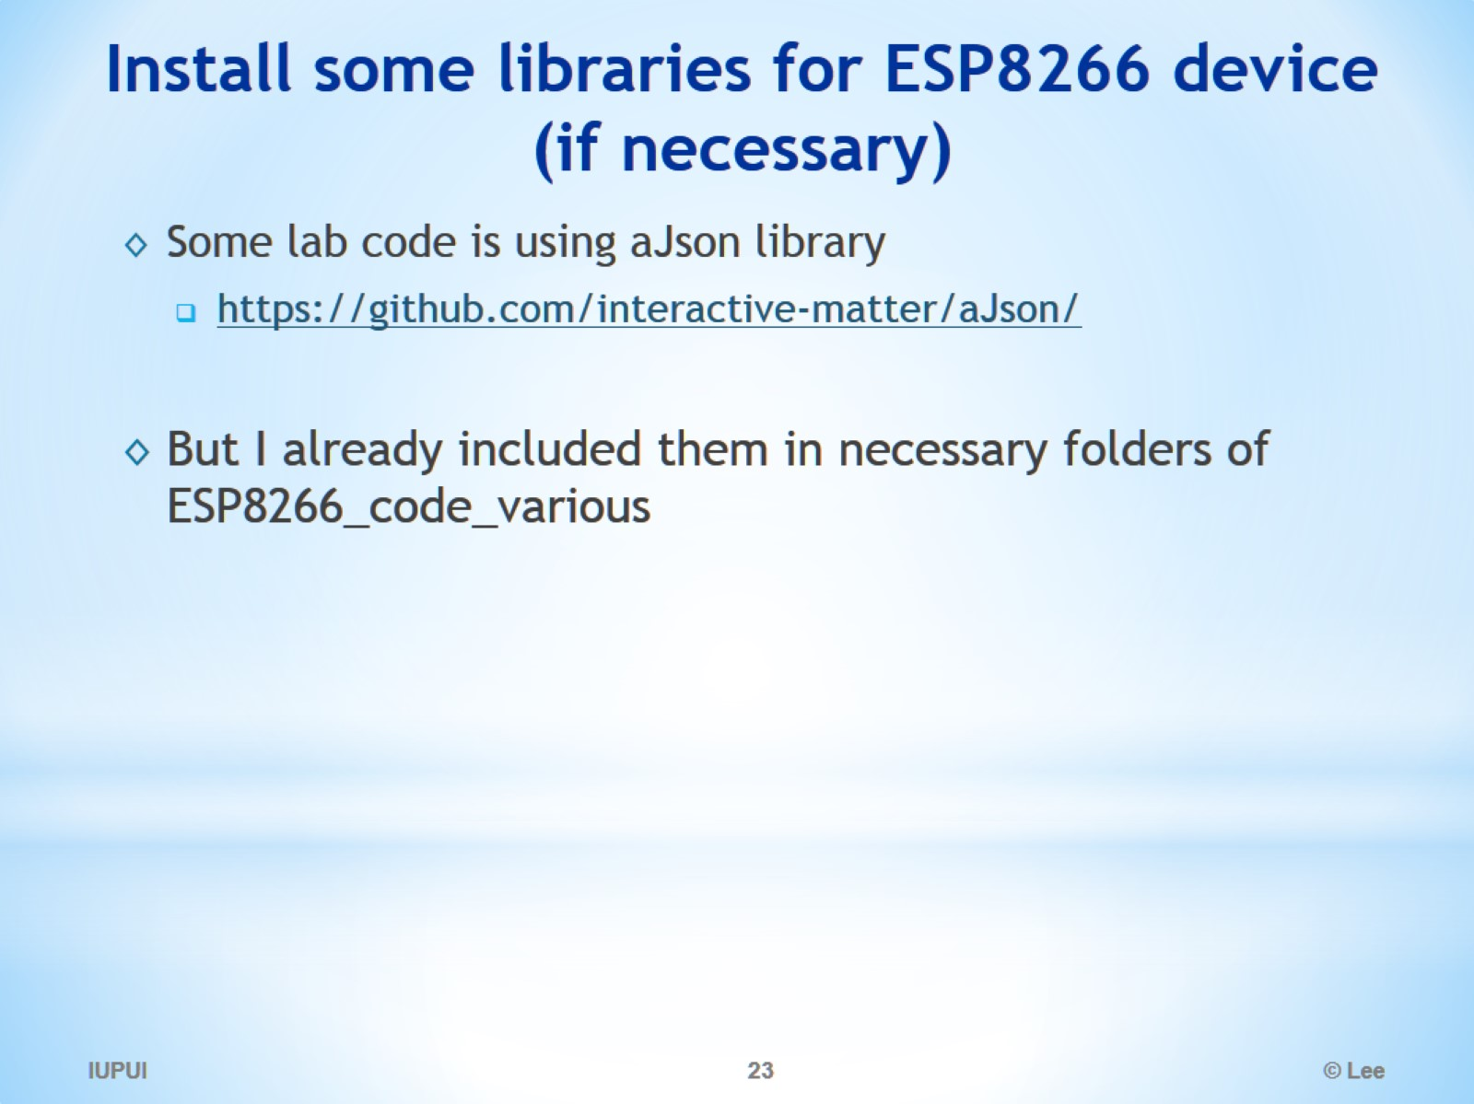
Install some libraries for ESP8266 device (if necessary)

Slide 24
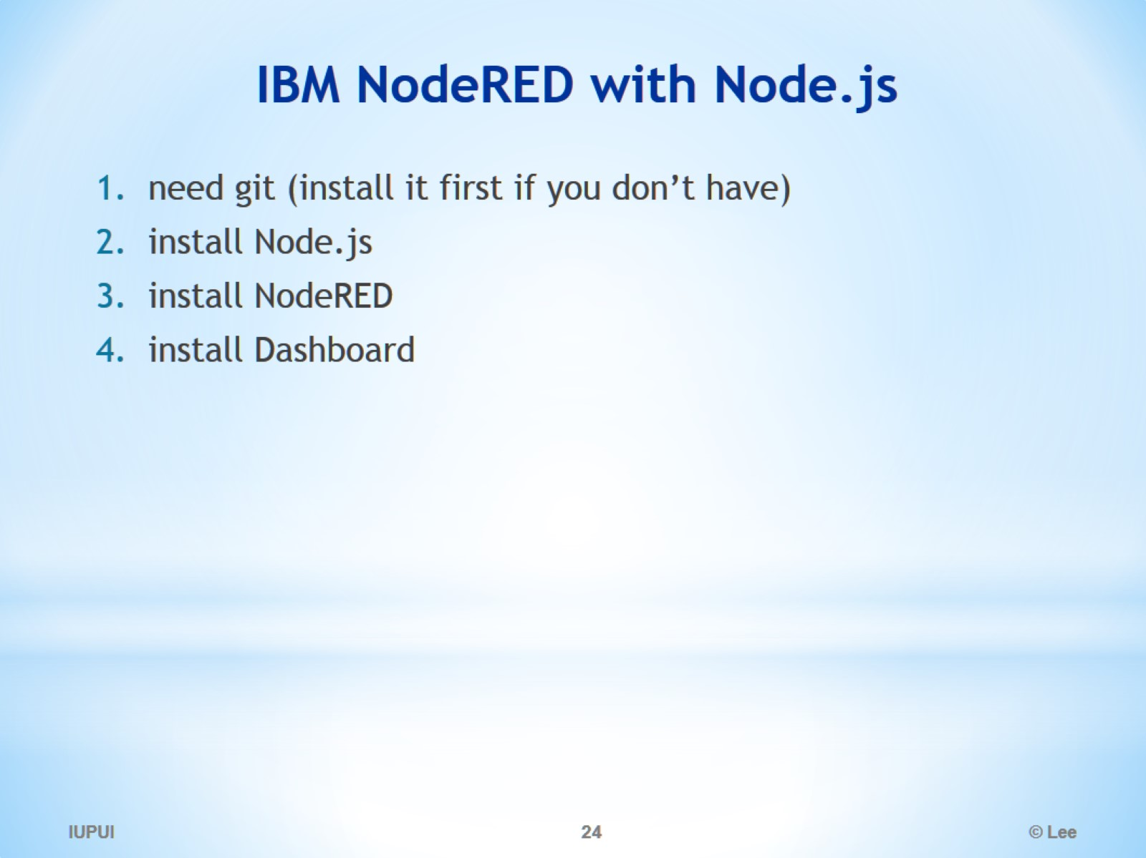
IBM NodeRED with Node.js

Slide 25
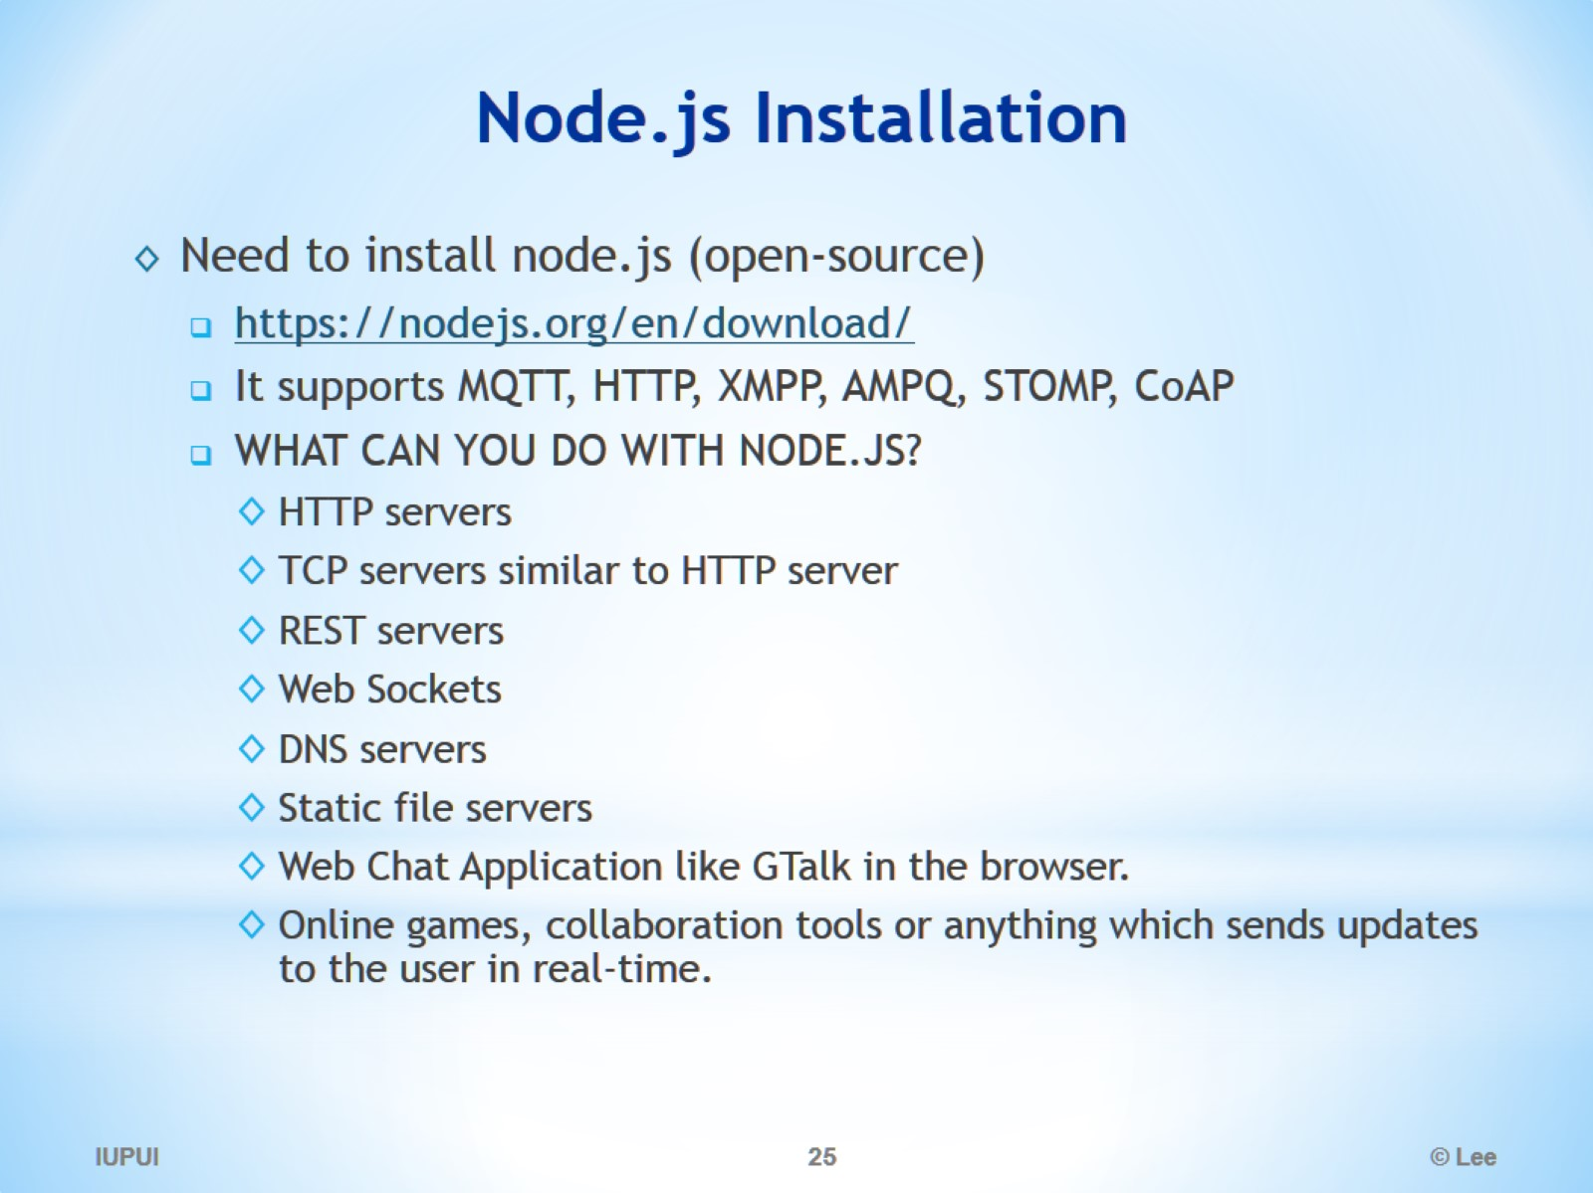
Node.js Installation

Slide 26
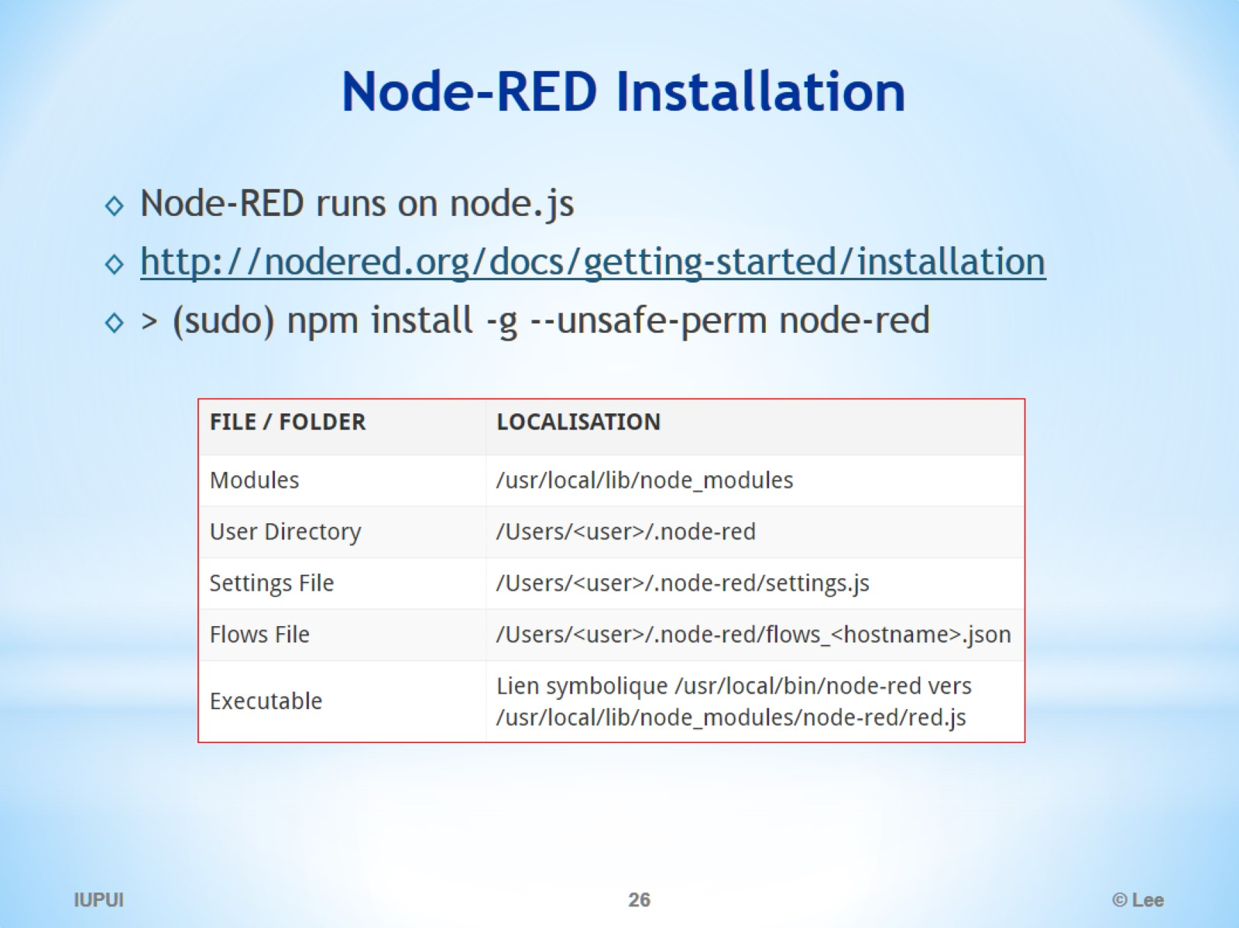
Node-RED Installation

Slide 27
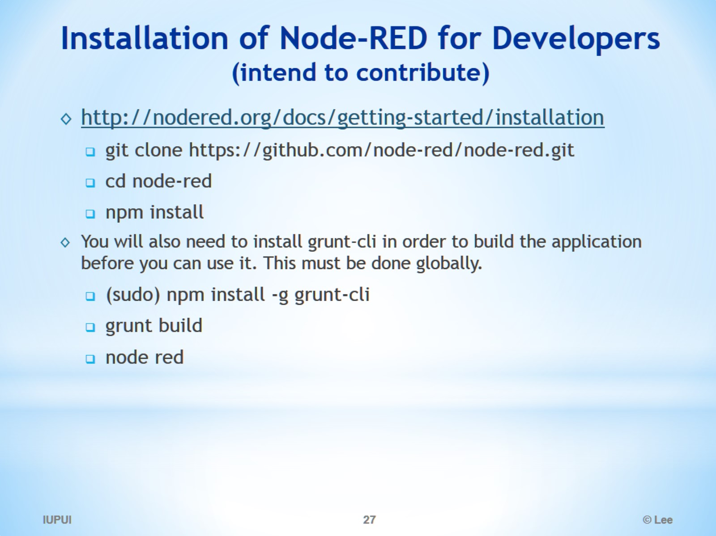
Installation of Node-RED for Developers (intend to contribute)

Slide 28
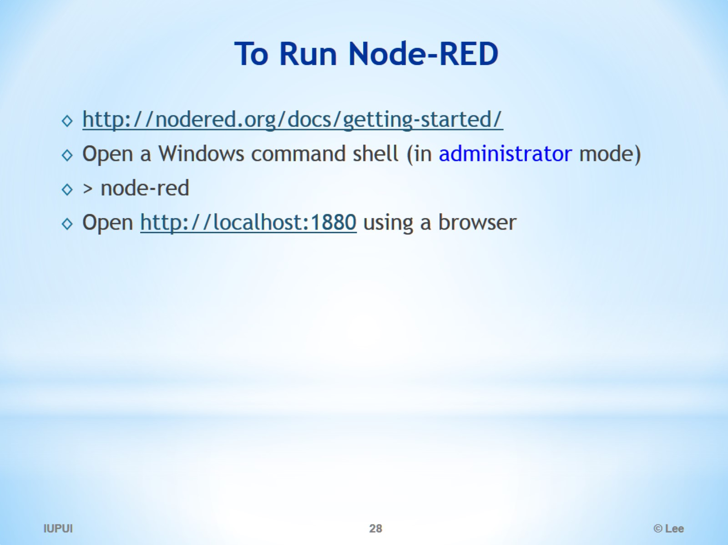
To Run Node-RED

Slide 29
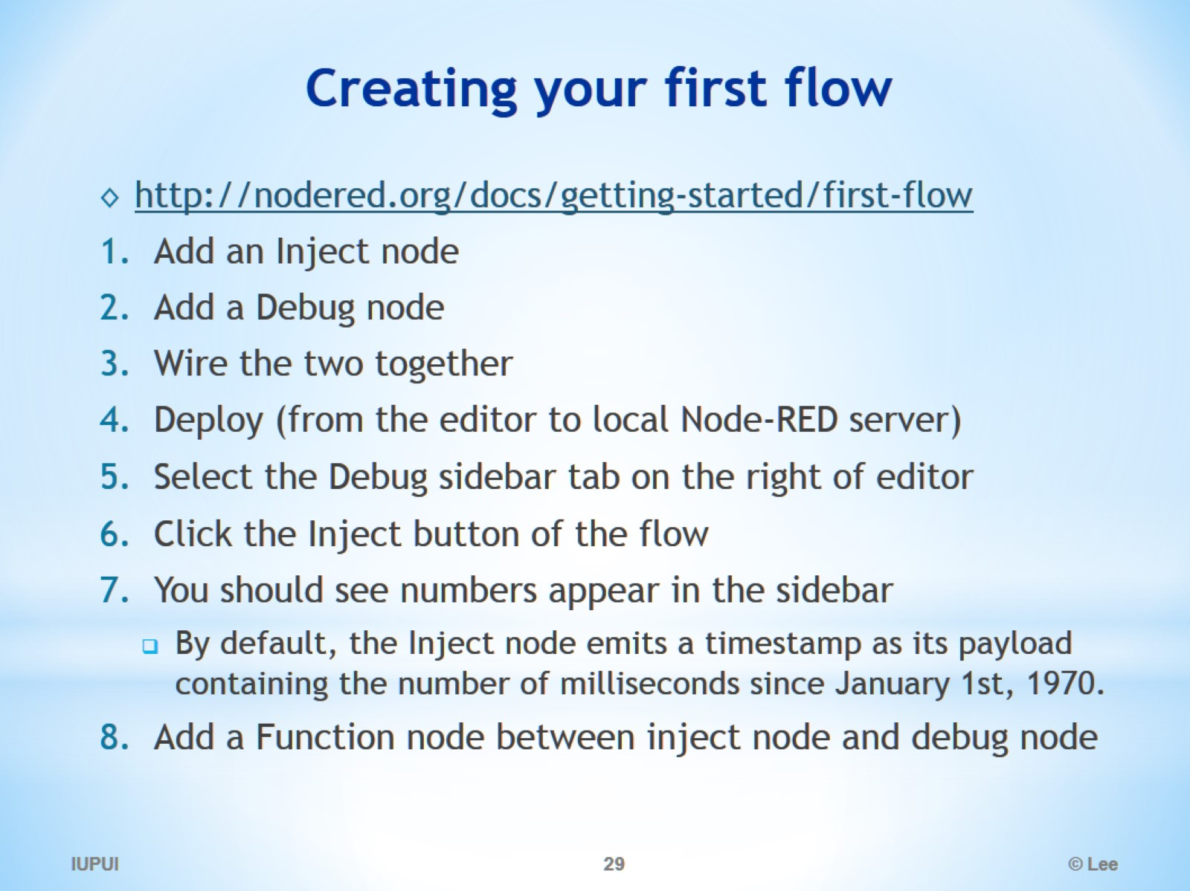
Creating your first flow

Slide 30
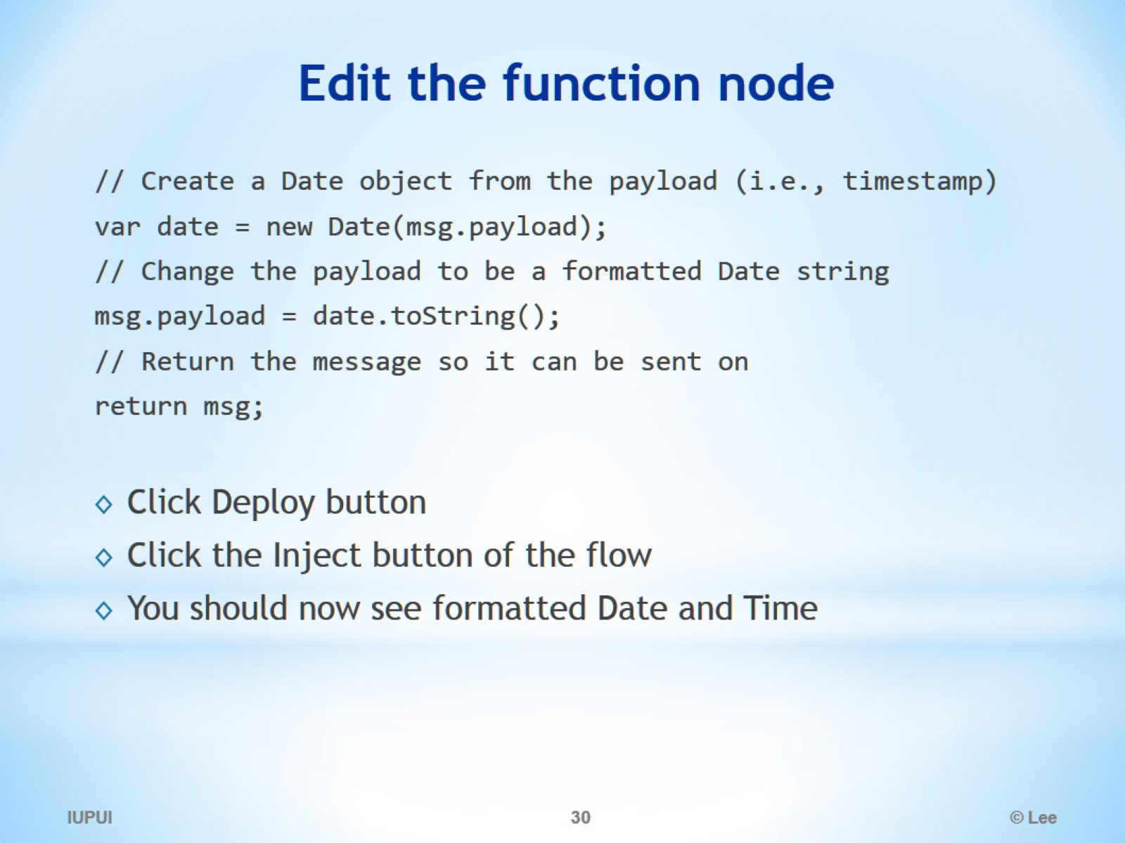
Edit the function node

Slide 31
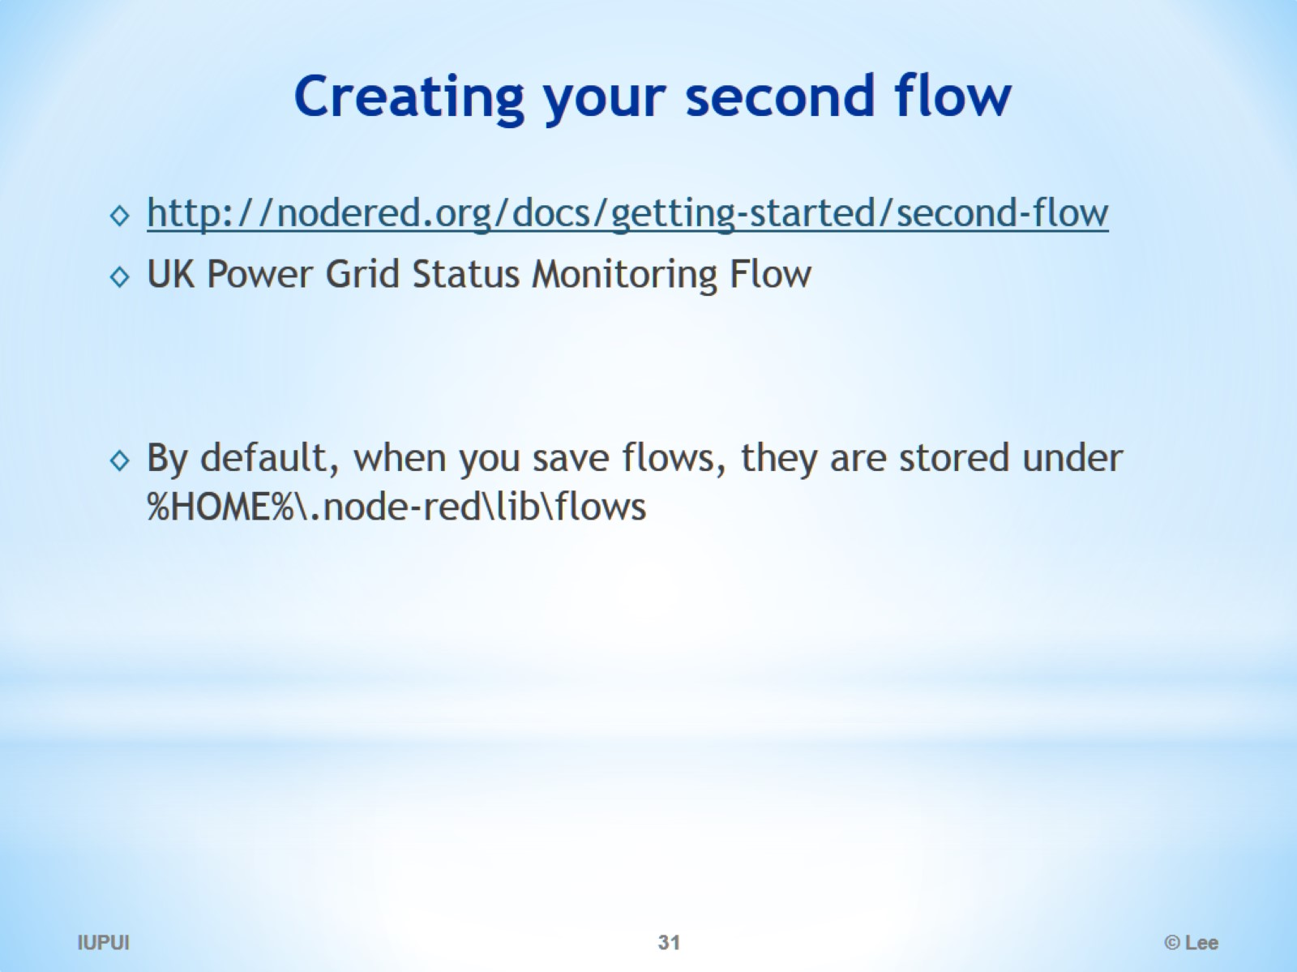
Creating your second flow

Slide 32
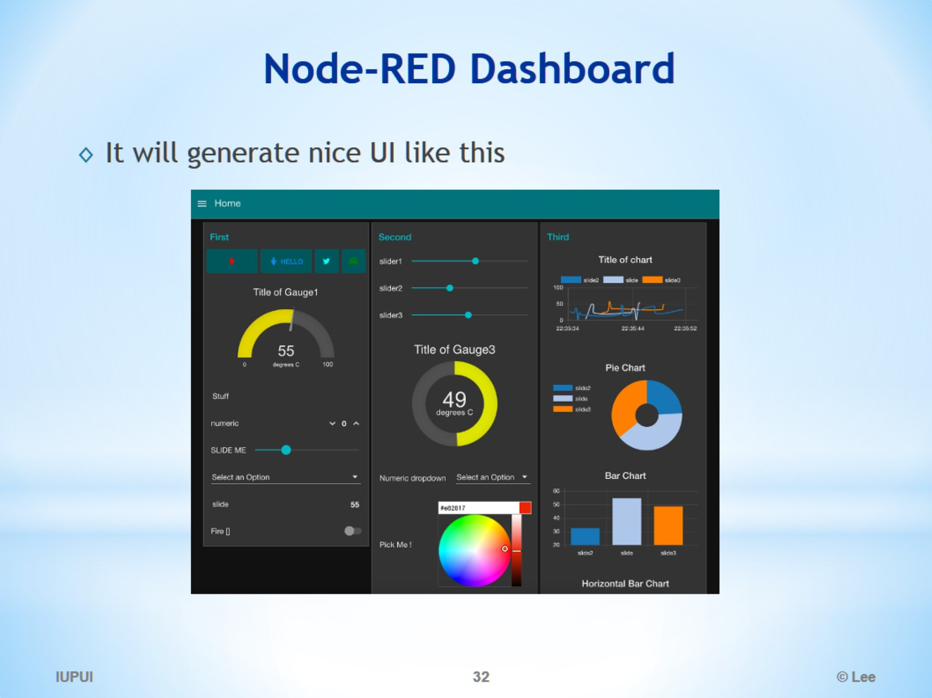
Node-RED Dashboard

Slide 33
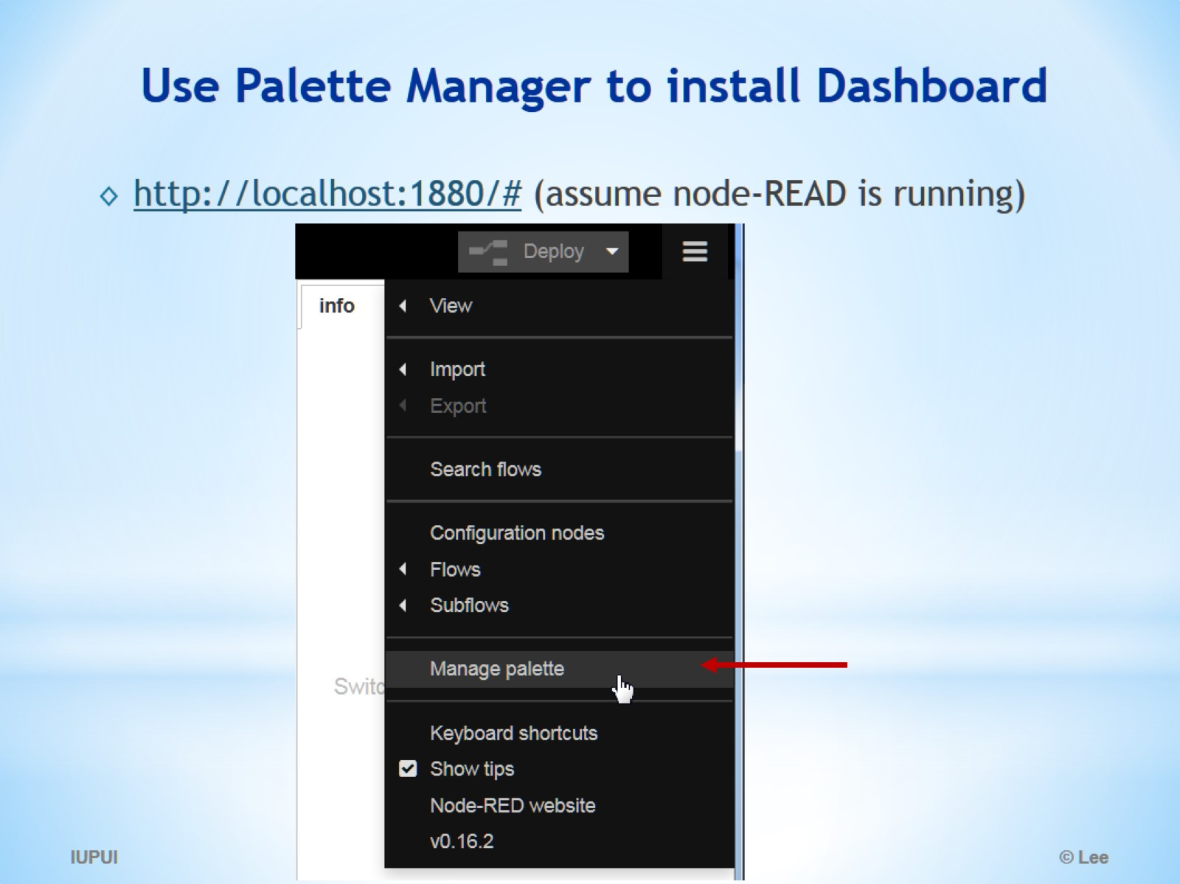
Use Palette Manager to install Dashboard

Slide 34
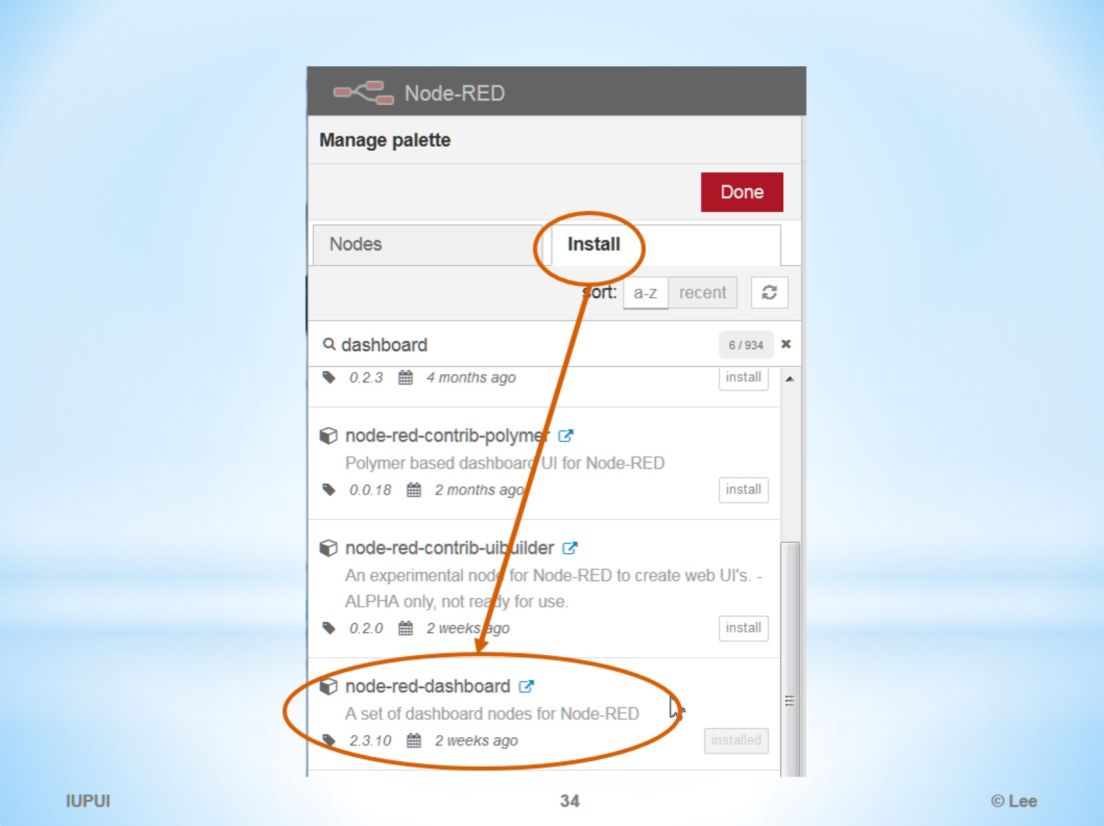

Slide 35
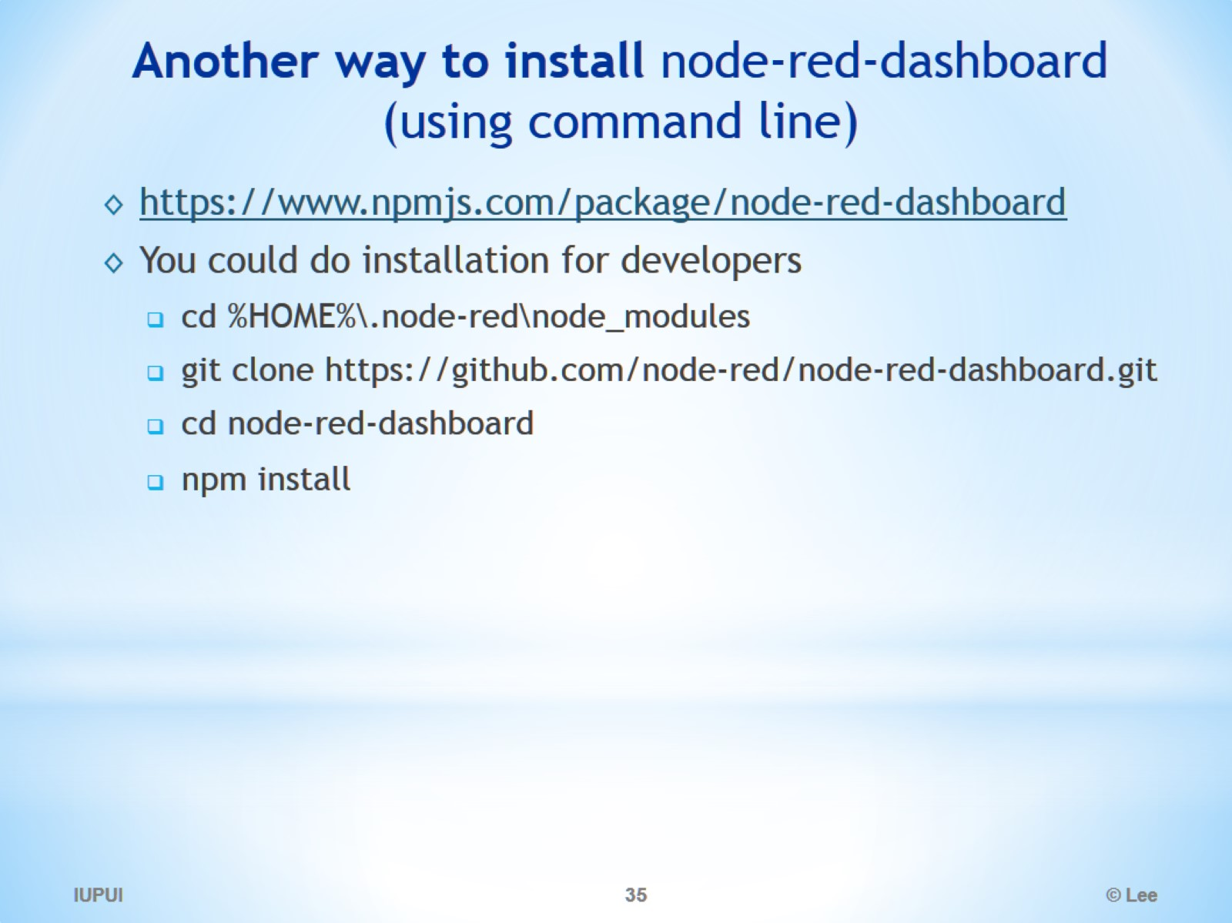
Another way to install node-red-dashboard (using command line)

Slide 36
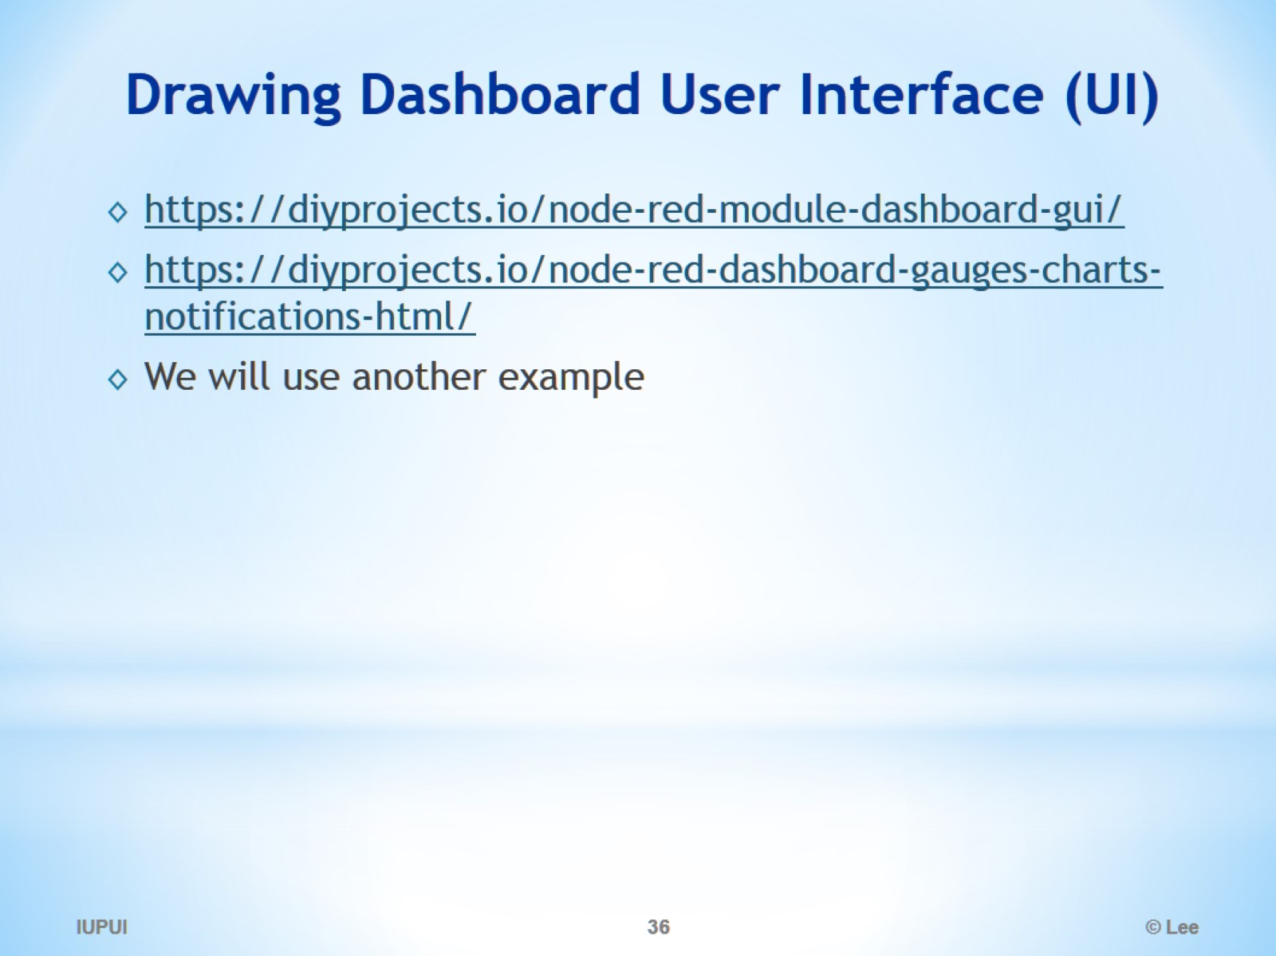
Drawing Dashboard User Interface (UI)

Slide 37
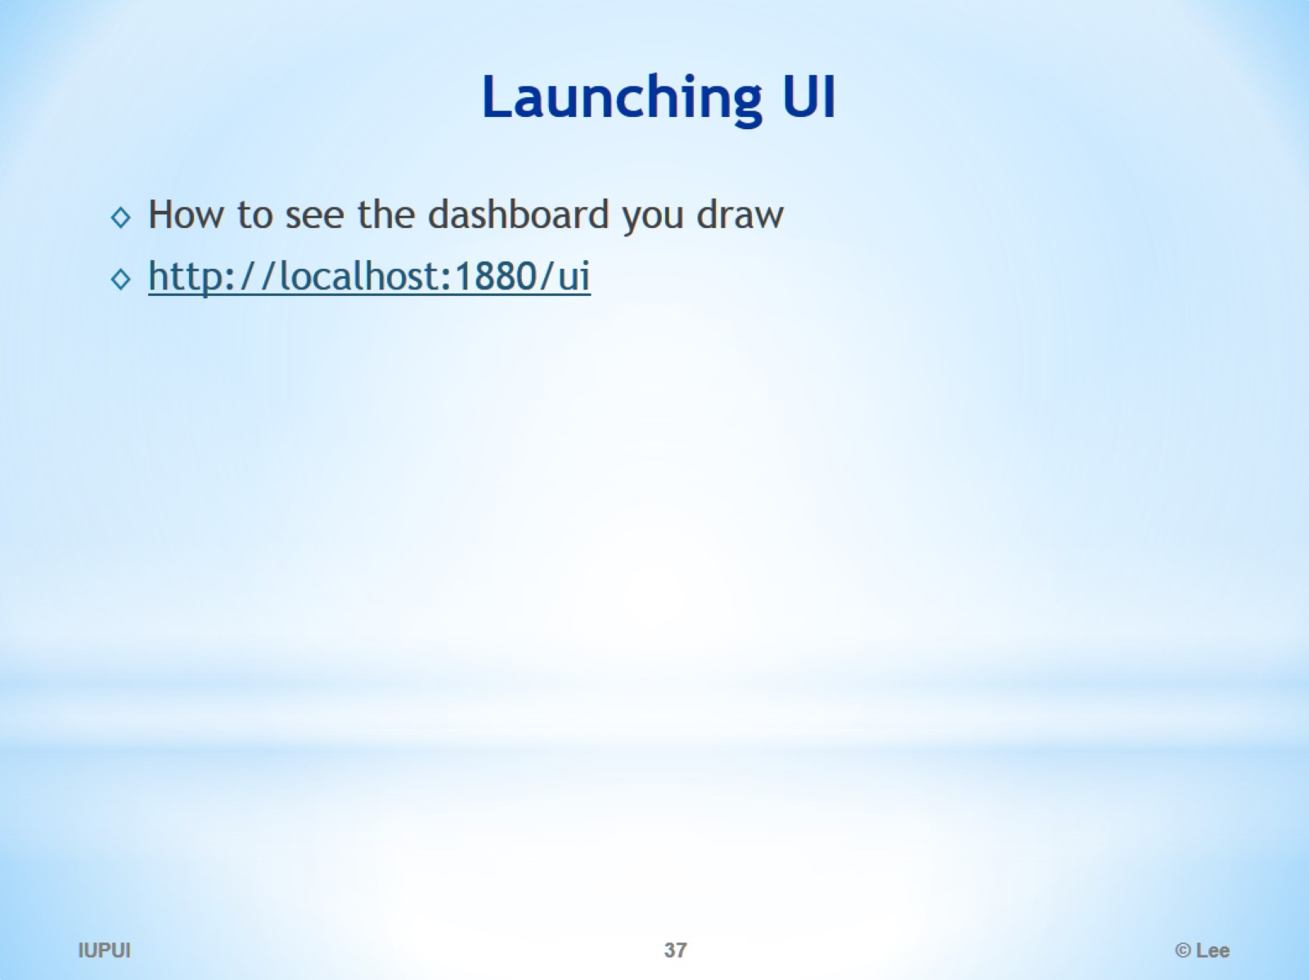
Launching UI

Slide 38
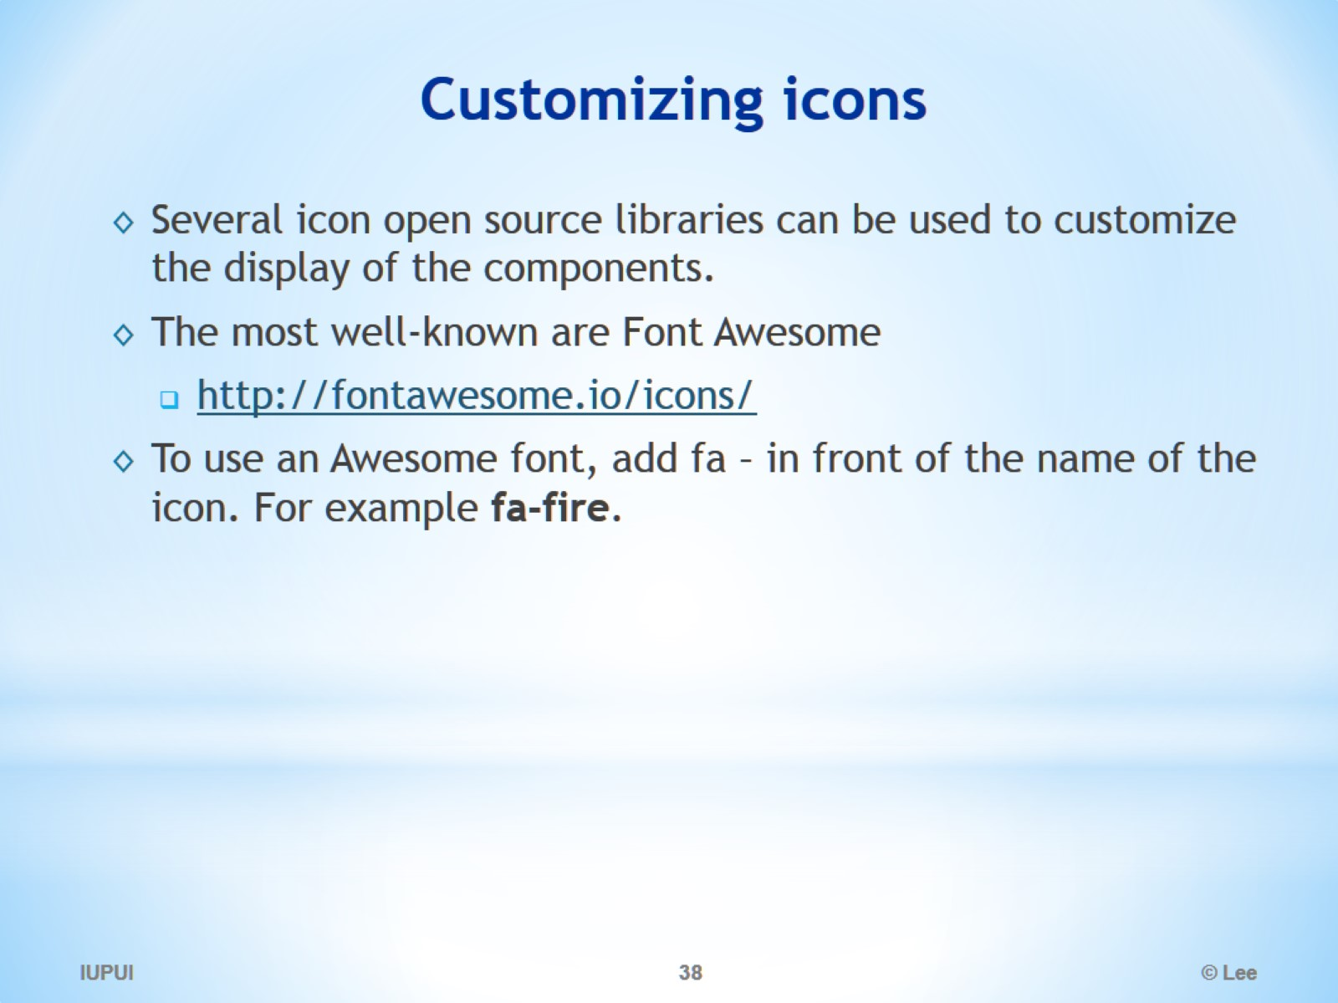
Customizing icons

Slide 39
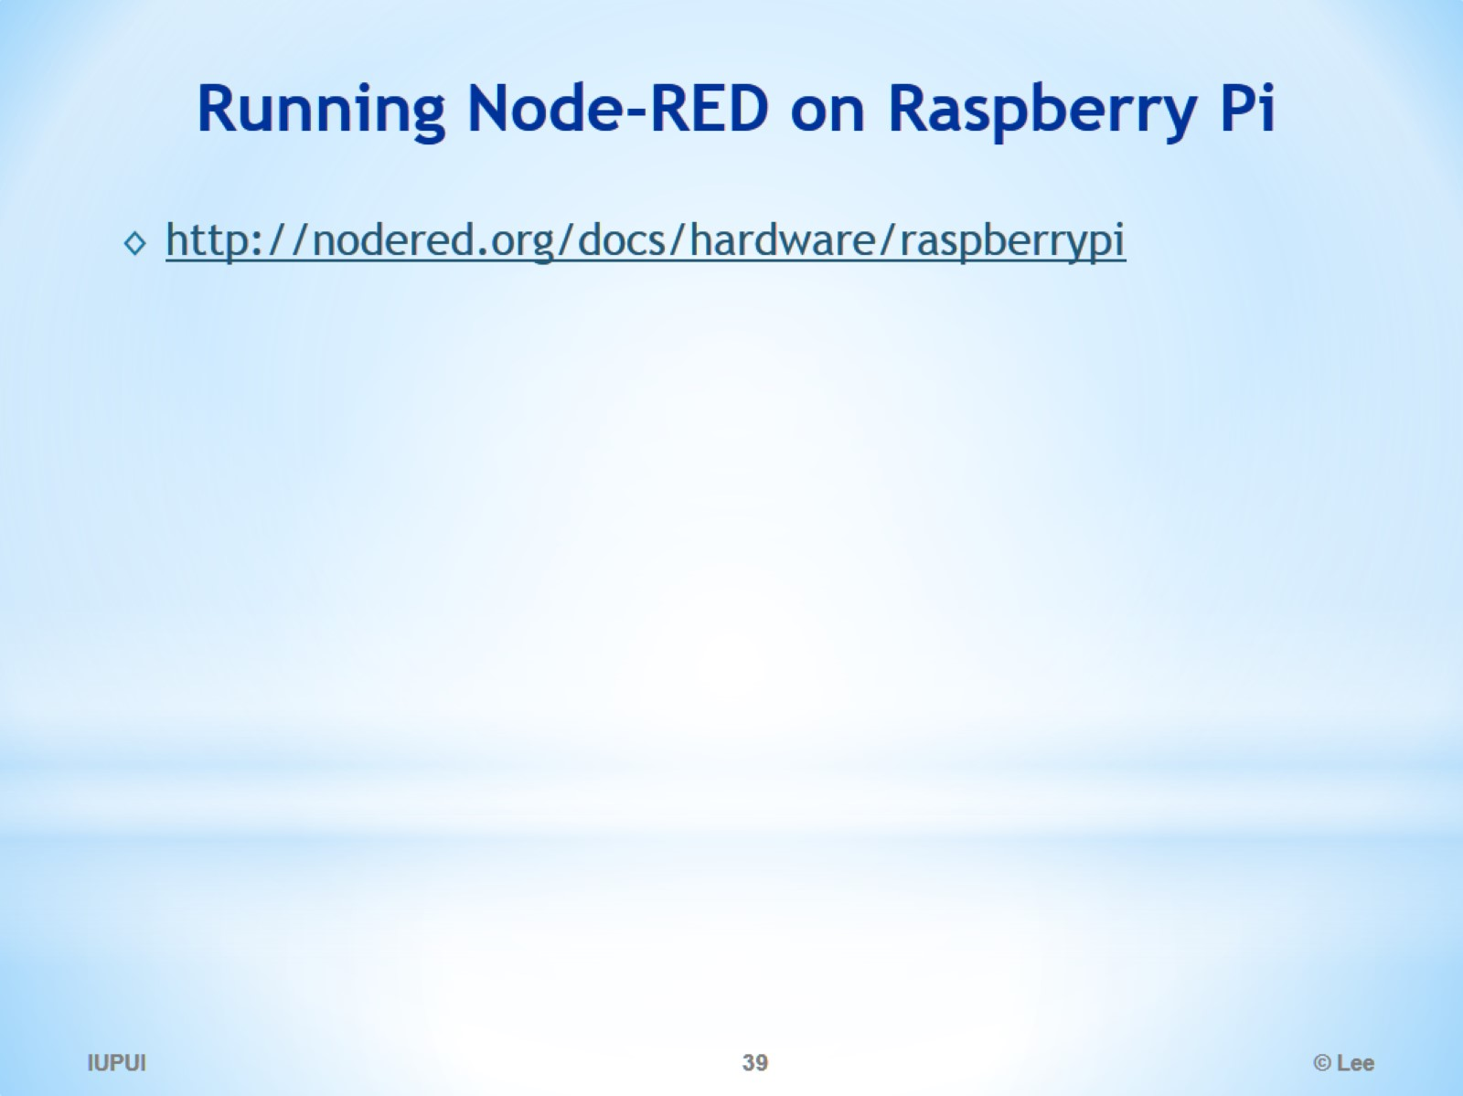
Running Node-RED on Raspberry Pi

Slide 40
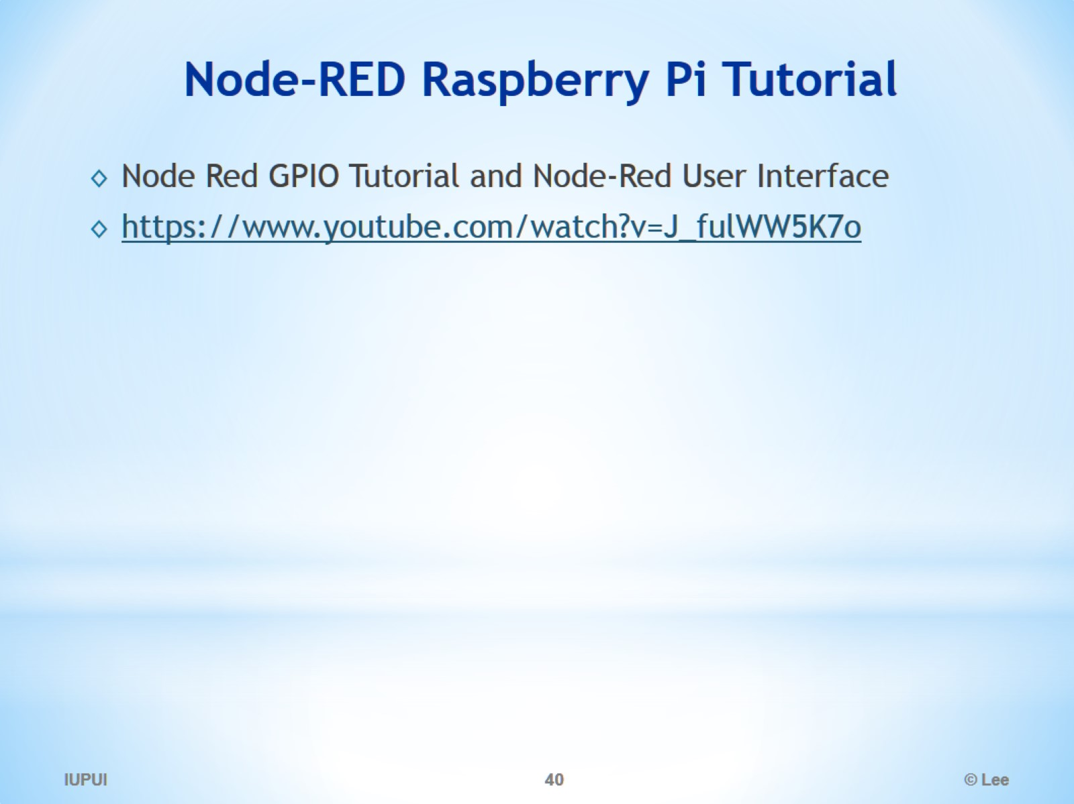
Node-RED Raspberry Pi Tutorial

Slide 41
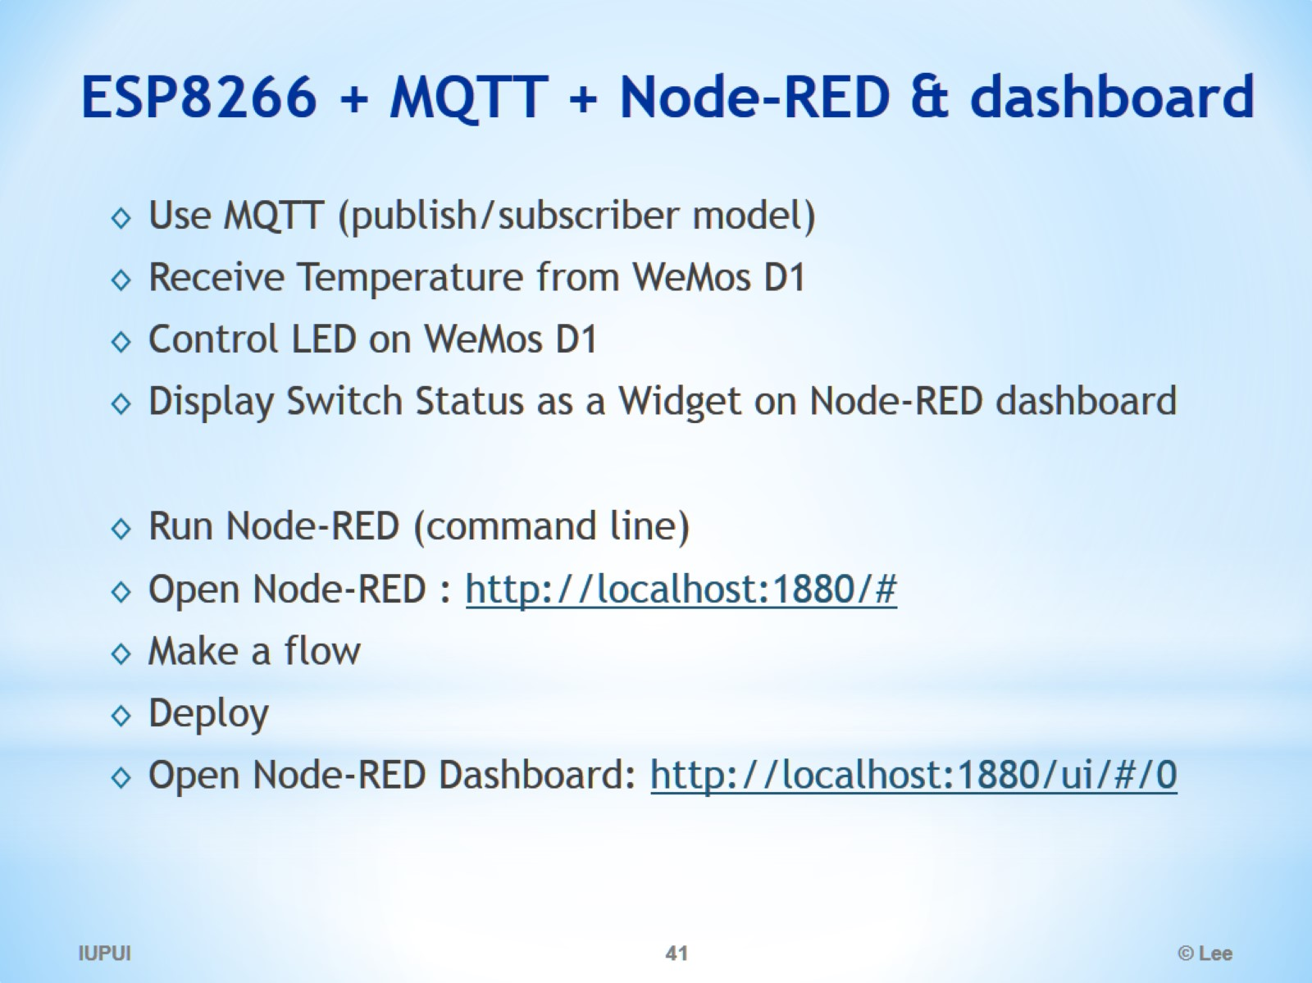
ESP8266 + MQTT + Node-RED & dashboard

Slide 42
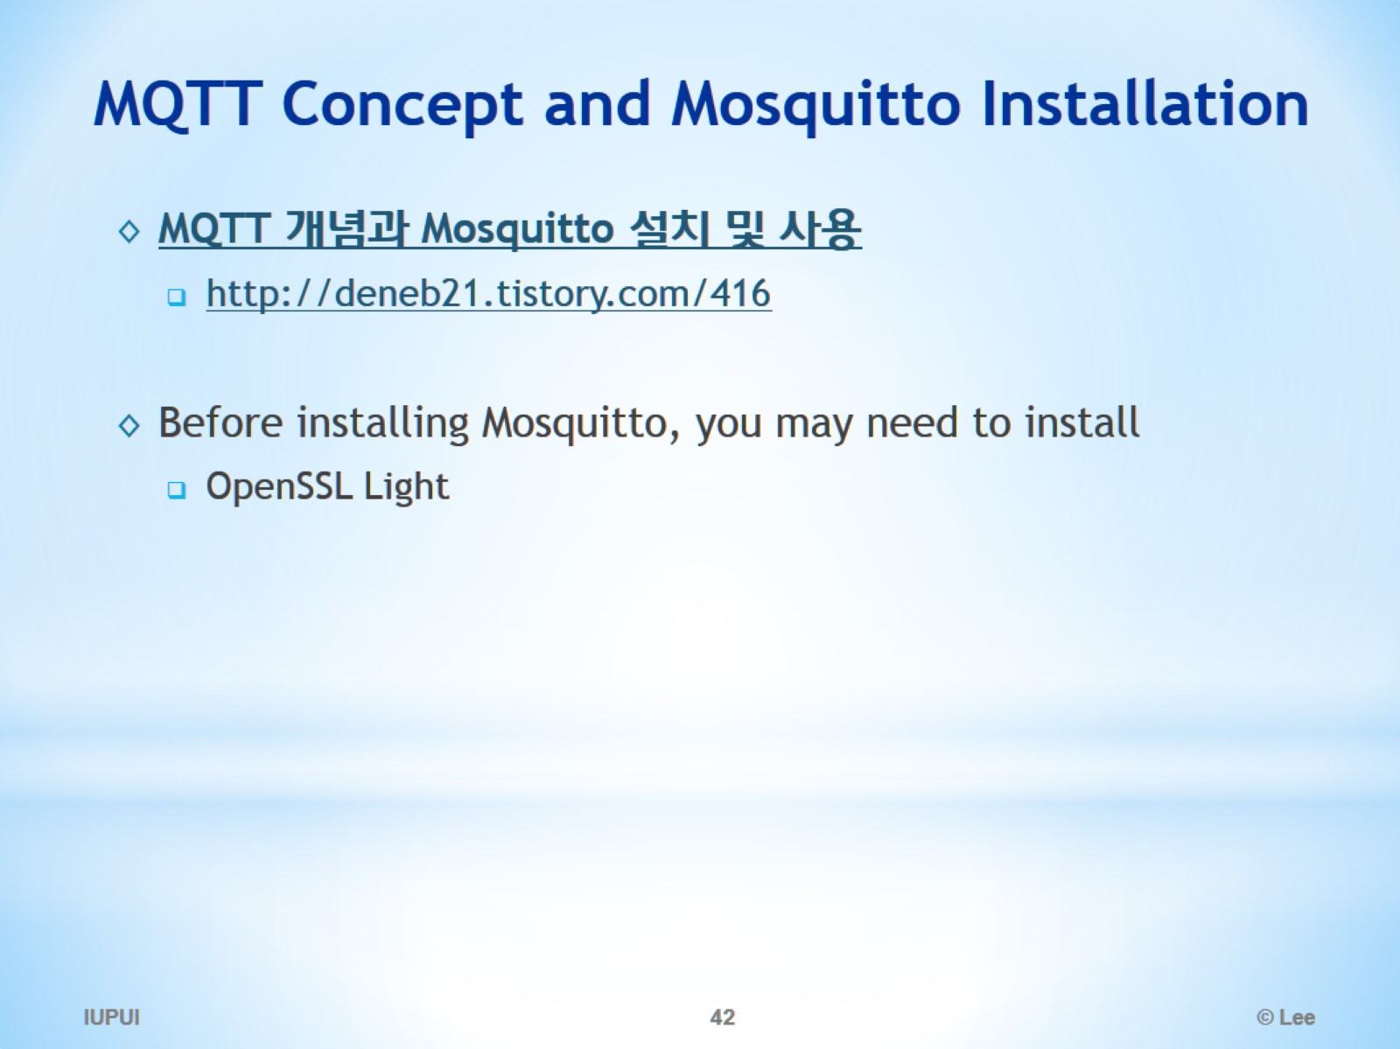
MQTT Concept and Mosquitto Installation

Slide 43
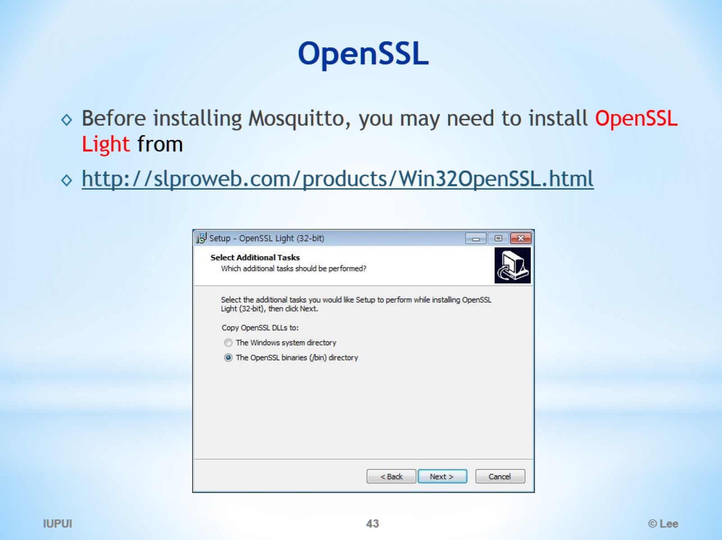
OpenSSL

Slide 44
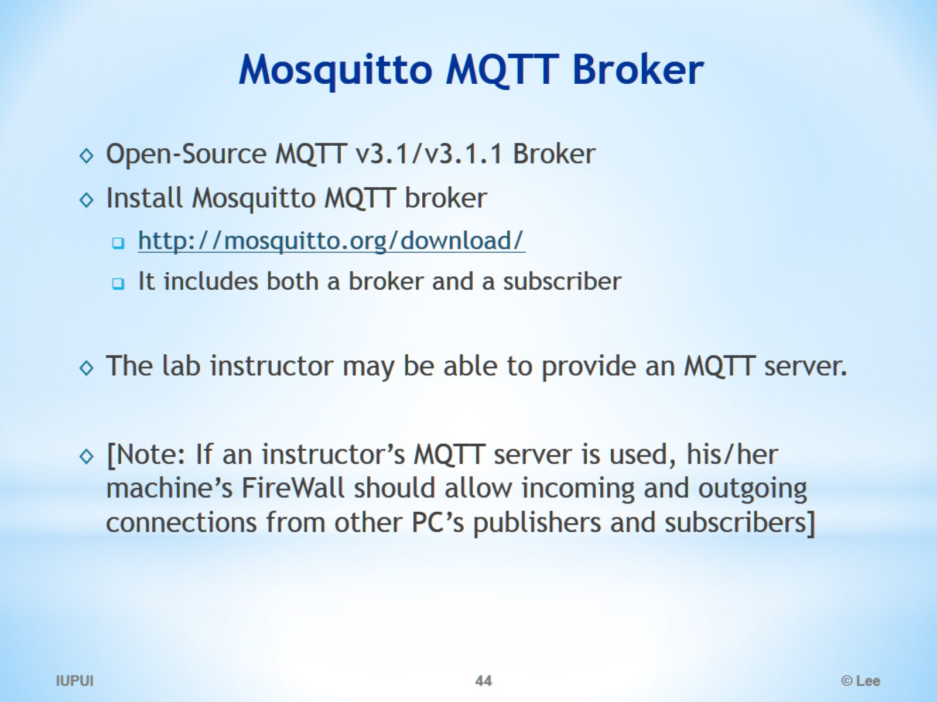
Mosquitto MQTT Broker

Slide 45
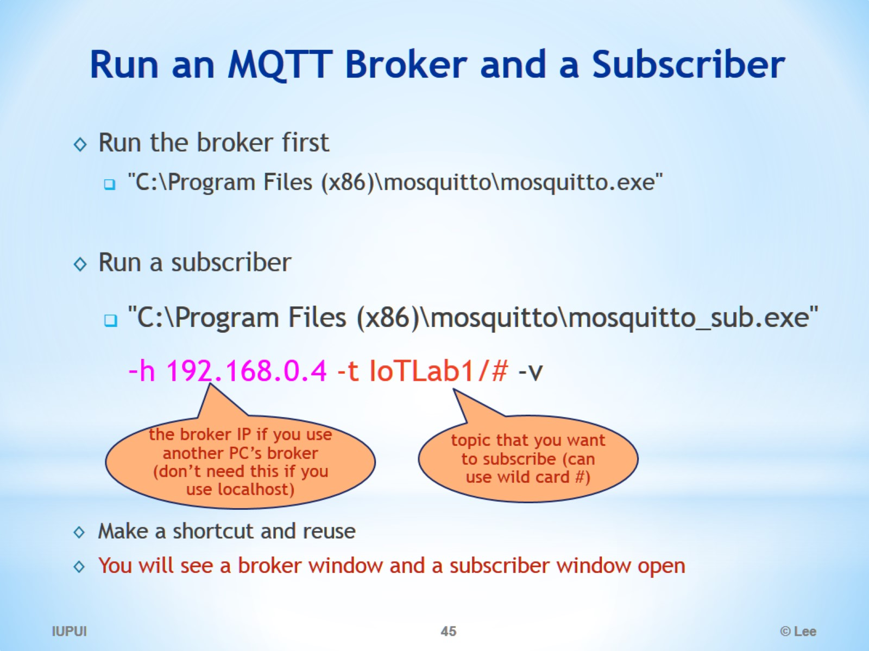
Run an MQTT Broker and a Subscriber

Slide 46
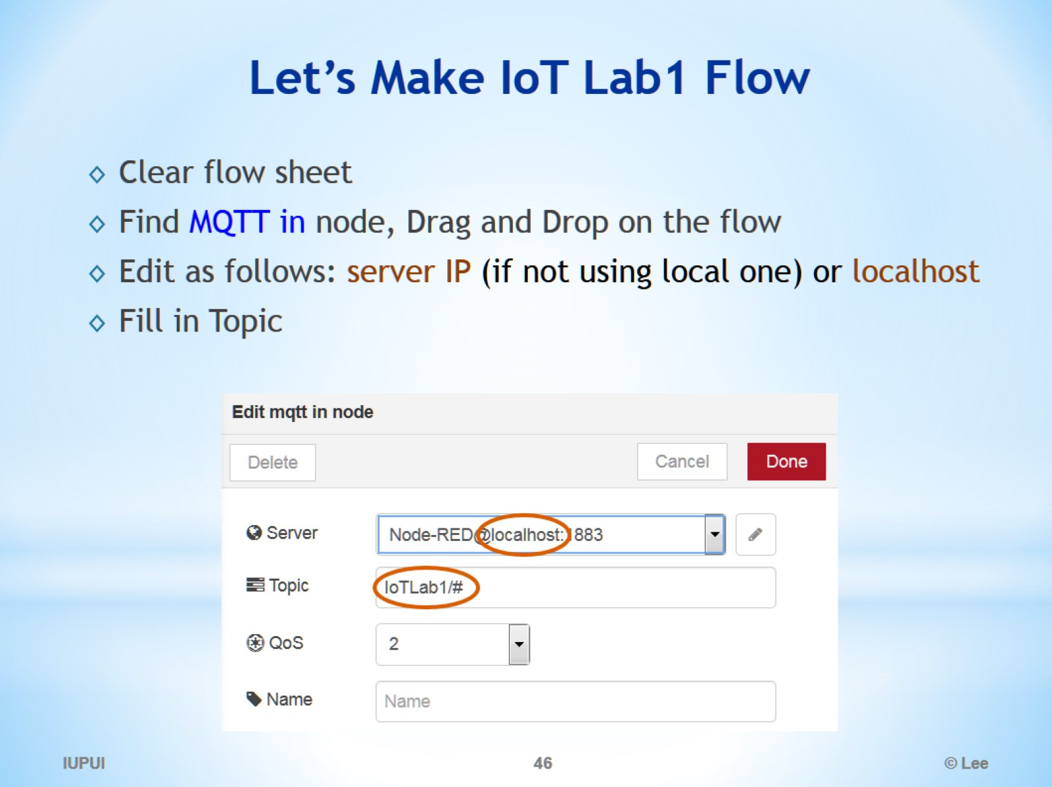
Let’s Make IoT Lab1 Flow

Slide 47
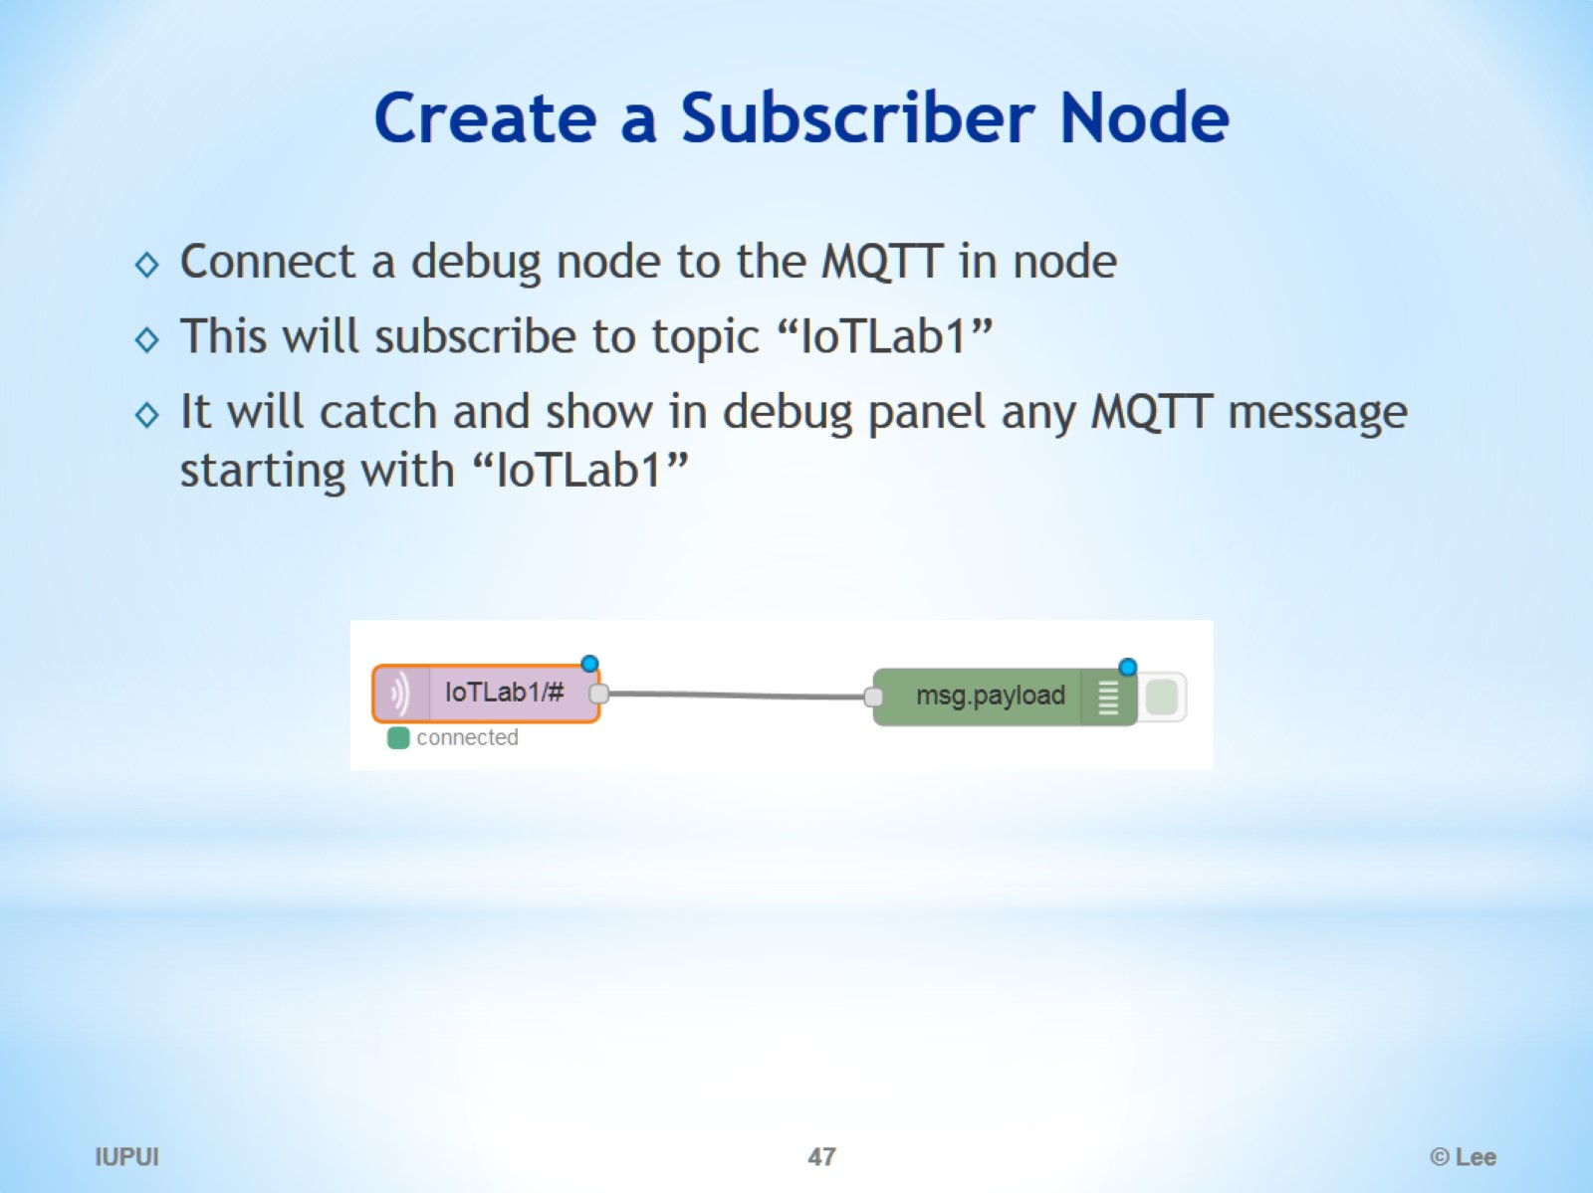
Create a Subscriber Node

Slide 48
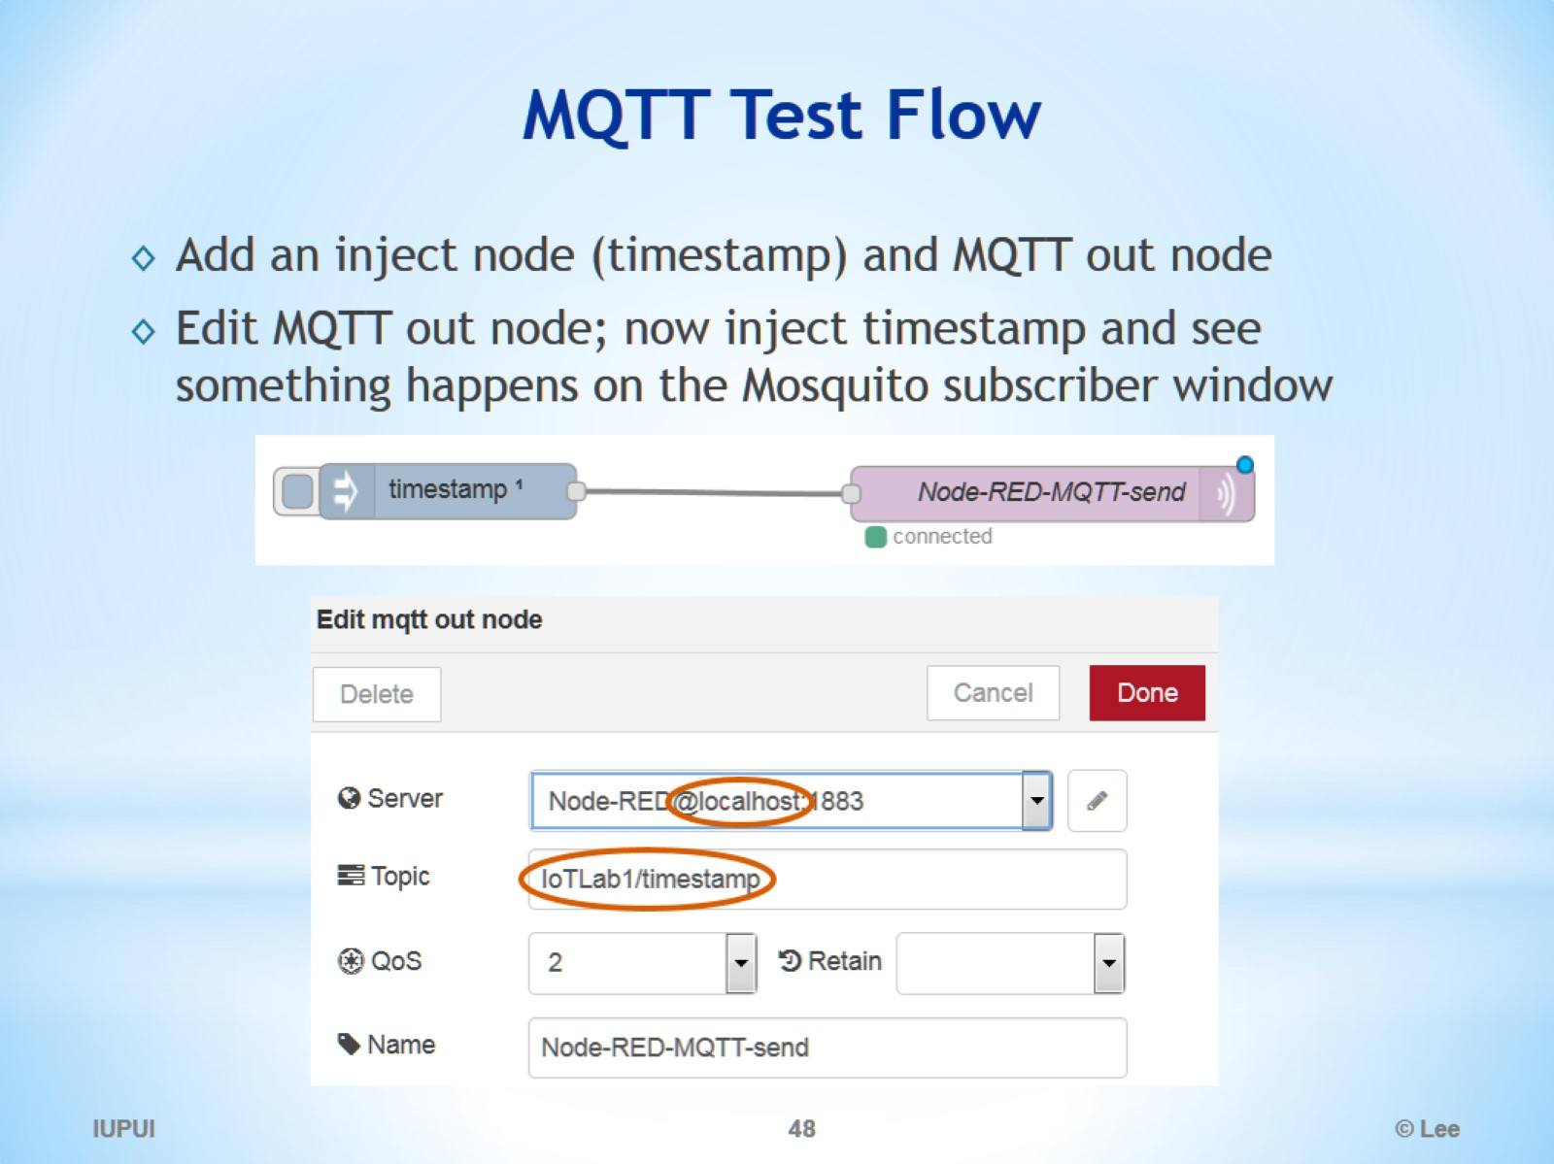
MQTT Test Flow

Slide 49
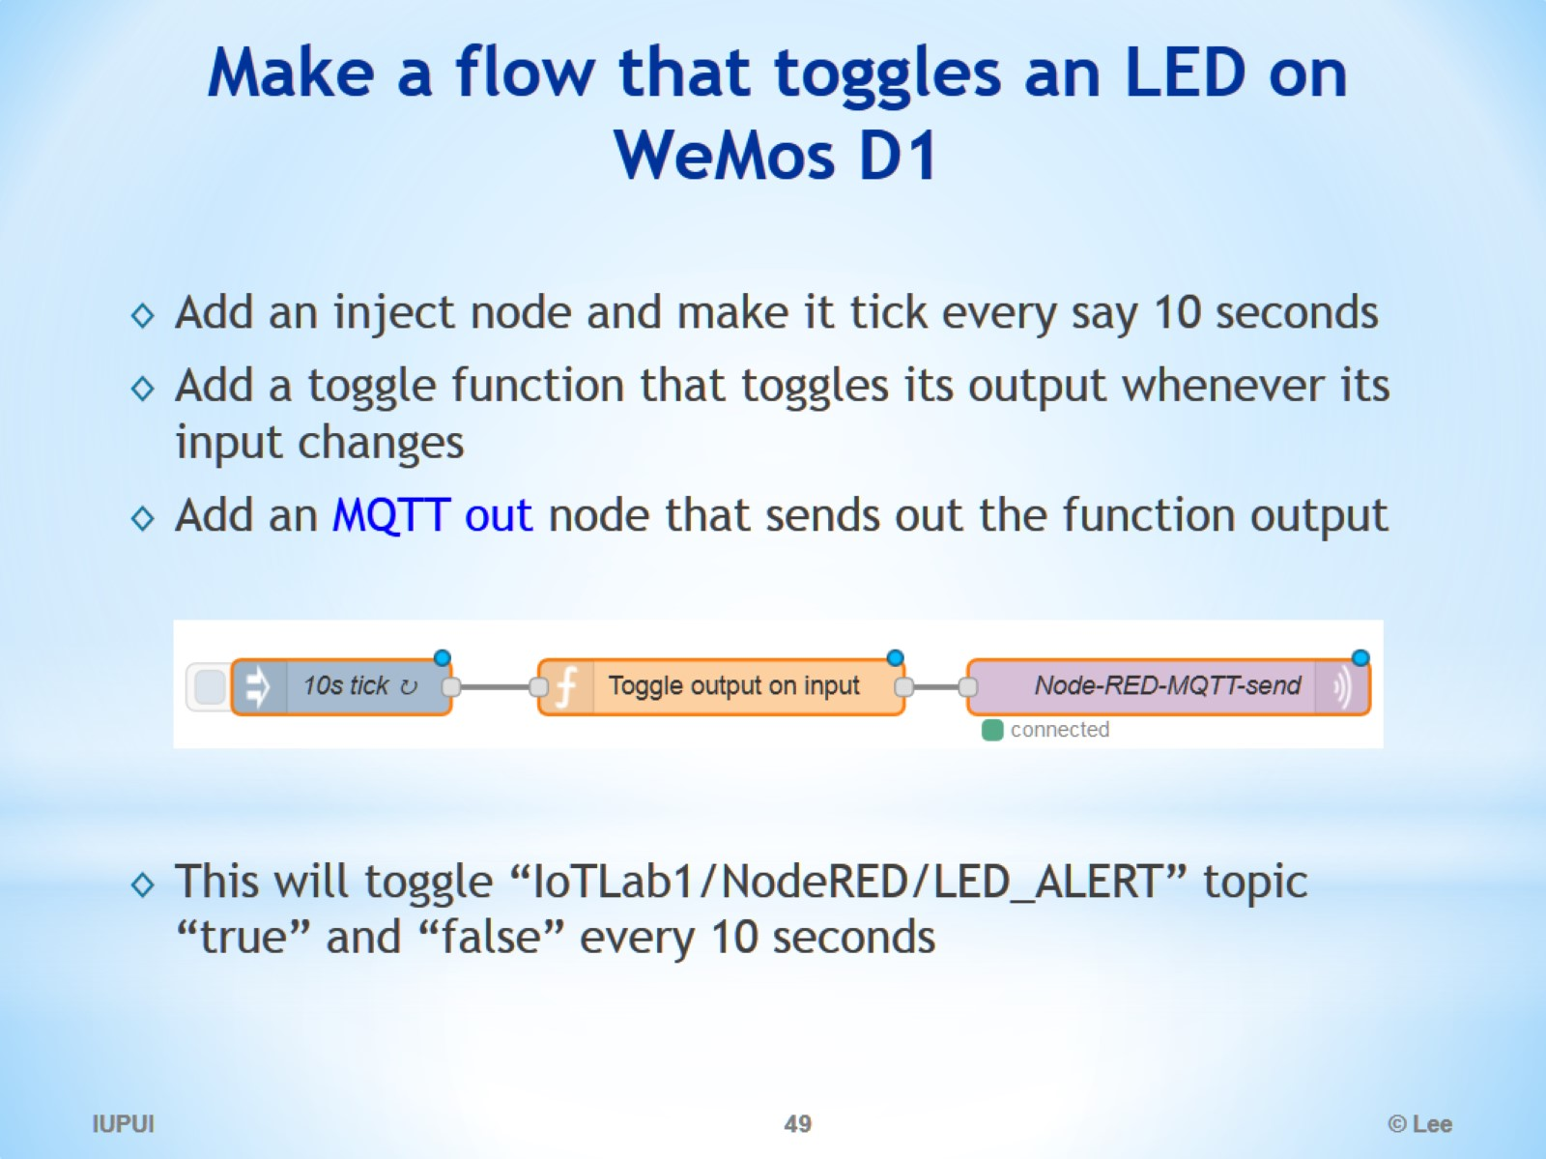
Make a flow that toggles an LED on WeMos D1

Slide 50
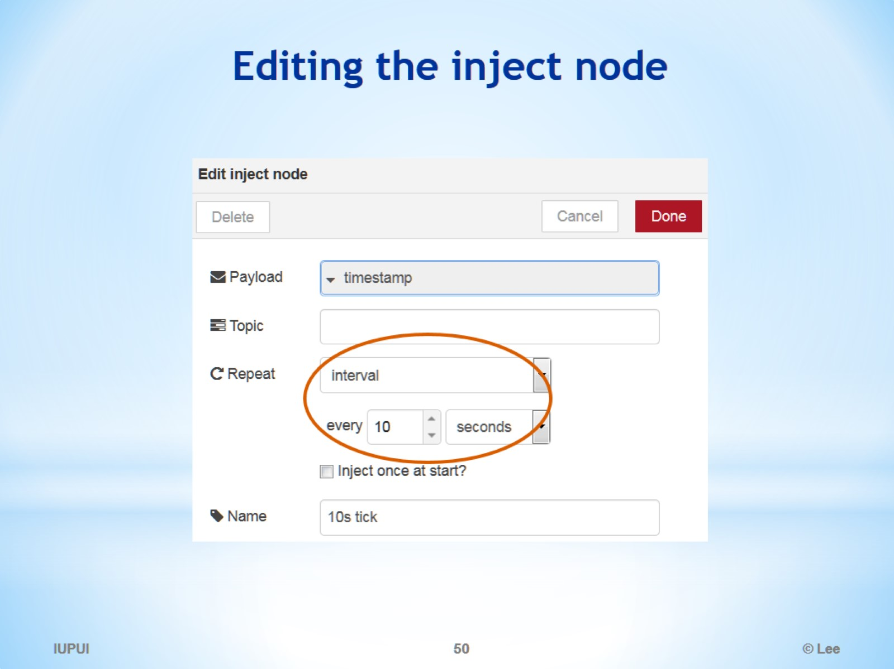
Editing the inject node

Slide 51

Editing the function node

Slide 52

Editing MQTT out node

Slide 53

Let’s Monitor a Switch and Display on Dashboard

Slide 54

Editing MQTT in node to sense Switch Change

Slide 55

Editing Gauge Node (for 1 or 0 display)

Slide 56

Electronics 101

Slide 57

Electronics 101 - Photoresistor

Slide 58

Electronics 101 – Switch

Slide 59

NodeRED Lab: Components needed

Slide 60

Wiring for Tutorials

Slide 61

What is WeMos D1 board?

Slide 62

WeMos D1 Pin Layout

Slide 63

How to connect my WeMos D1 to Flow

Slide 64

Setup target board, port, speed, etc.

Slide 65

How to connect WeMos D1 to Flow

Slide 66

If Compile Error due to unmatched Pubsubclient

Slide 67

Open NodeRED Dashboard

Slide 68

Complete Flow

Slide 69

IGNORE THE REST

Slide 70

Node-RED Arduino Tutorial

Slide 71

Install Node-RED Arduino library

Slide 72

Files - Examples - Firmata - SimpleDigitalFirmata

Slide 73

Import the Blink node

Slide 74

Modify Arduino output node

Slide 75


Slide 76


Slide 77

Running on IBM Bluemix

